Slide 1

LIVE
Improving Mental Health Care Through Inclusion and Compassion
Lessons from the Field
June 29, 2018
Notes:
Friday, June 29 4:00 – 5:30 CT
Improving Mental Health Care Through Inclusion and Compassion: Lessons from the Field
Join us for the first in-person NAMI Ask the Expert panel presentation at a NAMI convention! You’ll hear presentations from an expert panel consisting of a health care administrator, a medical school professor, a person with a mental health condition and a family member. Each will share the unique role that they have played in ensuring that people seeking mental health treatment were treated with respect, dignity and equality as a member of the treatment team.
Experts:
Terry Bridges, Executive Chairman, SUN Behavioral, Franklin TN
Lisa Streyffeler, PhD, is an Assistant Professor and the Chair of Behavioral Medicine, Medical Humanities & Bioethics at Des Moines University-College of Osteopathic Medicine. She is a licensed psychologist with clinical interests in trauma and caring for pregnant and postpartum women with psychiatric illness. Her research interests include medical personnel selection, medical student well-being, and medical education pedagogy
Angelina Brown Hudson, Program Director, NAMI Greater Houston, Houston, Texas
Carlos Larrauri, RN, BSN

Slide 2
Presentations from health care provider perspectives
Responses to presentations
Moderated Q & A
Notes:
Paul –
Welcome
Explain how the session is structured
Introduce Ken

Slide 3
Terry Bridges
Dr. Lisa Streyffeler
Angelina Brown Hudson
Carlos Larrauri
Notes:
Ken
Introduce panelists then turn it over to Terry
Presenters:
Terry Bridges is the Executive Chairman of SUN Behavioral based in Franklin, Tennessee. Terry began his journey volunteering as a teenager at a state psychiatric hospital where he was struck by the poor treatment conditions and cynical attitudes of the staff which inspired him to try and make a difference in the care of the mentally ill and their families.
Beginning as a clinician then feeling he could make a larger impact by supporting others provide care he went on to impact and expand services across the nation supervising services in some of largest healthcare systems most recently retiring from his role as President of Behavioral Services at HCA. Terry serves on the NAMI Tennessee Board as well as Jason Foundation (Youth Suicide Prevention) and has been named Executive Chairman of the Sun Behavioral Board and as a Director on the Odyssey Behavioral Board. Terry states constantly that NAMI has more opportunity to touch lives than any other organization in America.
Dr. Lisa Streyffeler, is an Assistant Professor and the Chair of Behavioral Medicine, Medical Humanities & Bioethics at Des Moines University-College of Osteopathic Medicine. She is a licensed psychologist with clinical interests in trauma and caring for pregnant and postpartum women with psychiatric illness. Her research interests include medical personnel selection, medical student well-being, and medical education pedagogy.
Panelists:
Angelina Brown Hudson is Program Director with the National Alliance on Mental Illness-Greater Houston. Her focus is to expand the number of NAMI education classes and support groups available in the Houston area supporting individuals and families who strive for recovery.
Angelina attended her first NAMI education class in Fall 2000 while navigating resources for her son’s brain disorder which took several years to specifically diagnosis. Her motivation and energy to inspire others comes from her desire to help and support others in the same manner by which she has found support through NAMI.
She has been involved with supporting families for more than 15 years providing encouragement, referrals and advocacy for those facing mental illness in the areas of education, healthcare, housing and employment. With NAMI, she works to help families build their emotional stamina, construct support networks and locate resources to sustain recovery and resilience.
Carlos A. Larrauri, MSN, ARNP, FNP-BC is a member of the NAMI Board of Directors, and Advanced Registered Nurse Practitioner in Miami, Florida. Carlos is a member of NAMI Miami-Dade County where he also serves on the affiliate Board of Directors.
Carlos came to NAMI seeking help and support after being diagnosed with Schizophrenia. Within the support group setting, he found a space where he felt comfortable disclosing his diagnosis and discussing the challenges of living with a serious mental illness. The community provided by NAMI and its programs are at the heart of his recovery. Carlos hopes to assist communities and organizations develop systems for the prevention and treatment of serious mental illness in adolescents and young adults through his/her affiliation with NAMI.

Slide 4
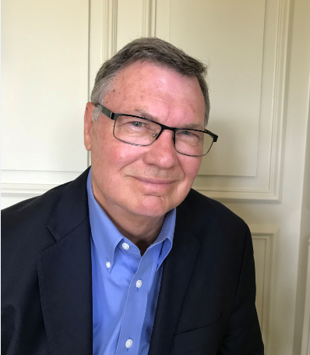
Terry Bridges, MS
Executive Chairman, SUN Behavioral, Franklin TN
Notes:
Terry – 15 minutes
shares thoughts about why it is important for health care organizations to embrace the concept of working collaboratively with patients and their families
Why did HCA develop the competent caring dvd and see that information as critical for staff development?

Slide 5
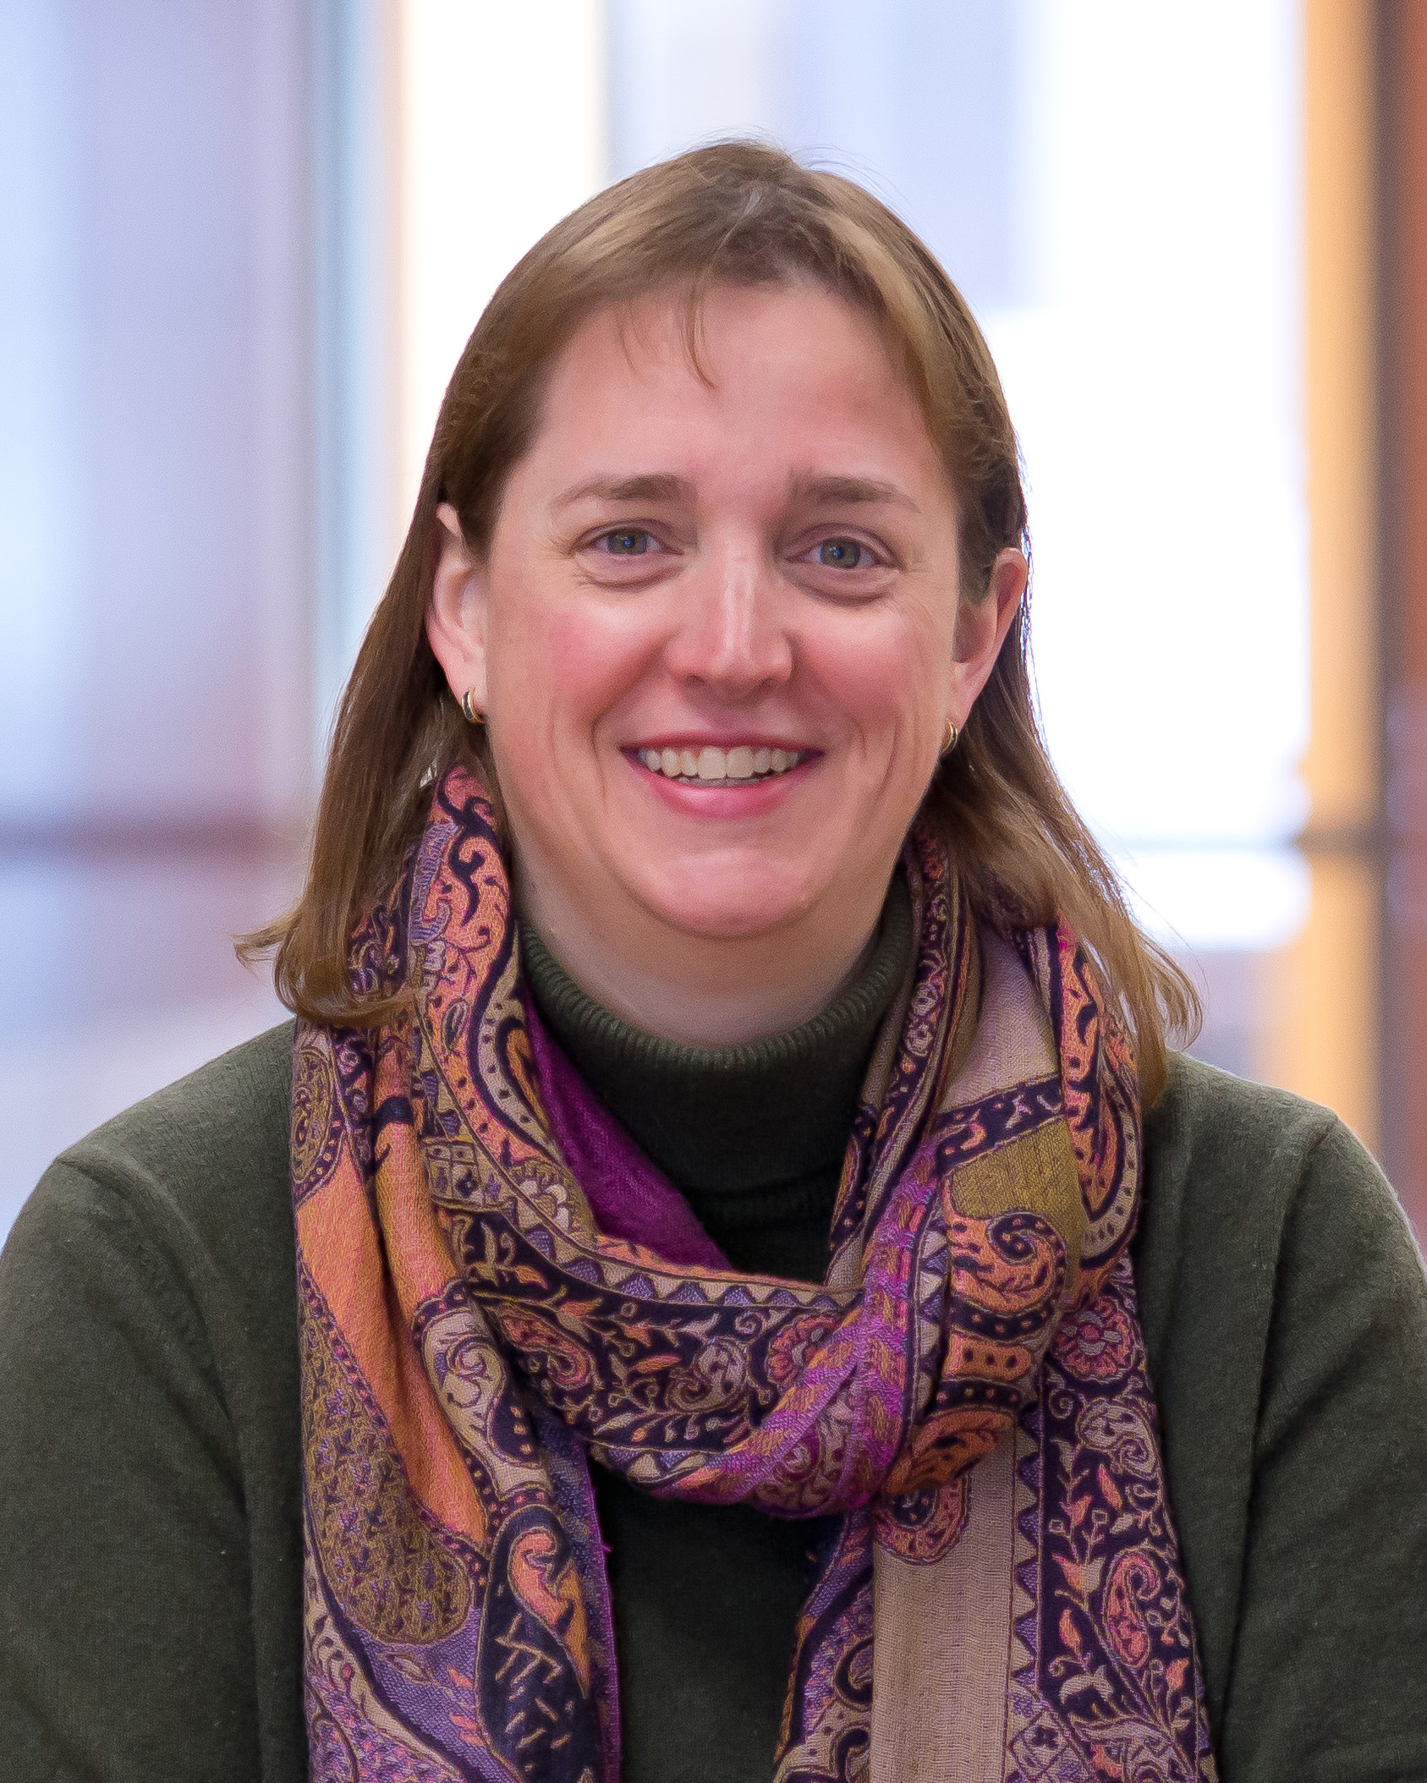
Lisa Streyffeler, PhD
Assistant Professor and the Chair of Behavioral Medicine, Medical Humanities & Bioethics at Des Moines University-College of Osteopathic Medicine
Notes:
Lisa 15 minutes
Who is DMU
why is it important for medical students to understand the lived experience of their patients
Why is it important to engage families in the treatment process

Slide 6
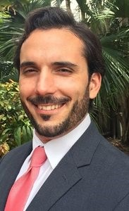
Carlos Larrauri M.S.N., A.R.N.P., F.N.P.-B.C.
Adjunct Professor of Psychiatric Mental Health Nursing
NAMI Board of Directors
NAMI-Miami Dade County Board of Directors
Notes:
Carlos will
respond to the presentations made by Terry & Lisa
Share his perspectives from the position of having a mental health condition himself and also being a nurse practitioner

Slide 7
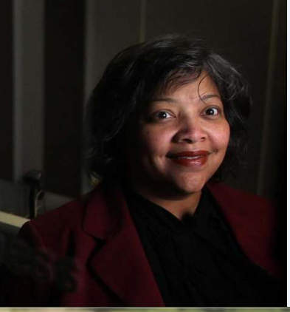
Angelina Brown Hudson
Program Director, NAMI Greater Houston, Houston, Texas
Notes:
Angelina will
respond to the presentations made by Terry & Lisa
Share her perspectives from the position of having a family member and also being a program director of NAMI Houston and a NAMI Provider teacher

Slide 8

Notes:
Q&A moderated by Ken – 25 minutes
2 questions from the room – then 1 from the phone

Slide 9
Additional resources for this session are available at
www.nami.org/asktheexpert
Please complete the session evaluation prior to
downloading the resources
Notes:
Paul will close the session
Reminding people to complete evaluation and download additional resources

Slide 10

Thursday, September 13 4:00 – 5:30 ET
Cultural Competence in Psychiatry
Dr. Maxey Gordon
Thursday, November 15 4:00 – 5:30 ET
Tips for Mental Health Caregivers
Grace Whiting, National Alliance on Caregiving
Sita Diehl
Notes:
Paul will remind people of upcoming Ask the Expert sessions

