Slide 1
Cultural Competence in Psychiatry
Presenter
Maxie L. Gordon, M.D., Psychiatrist
September 13, 2018
Notes:
Elise Padilla MSW, MBA is the Director of the STAR Center, a NAMI program, offering Technical Assistance focused on Youth Leadership as well as Peer Advocacy and Organizational Development. She identifies as a peer in recovery who has been an advocate focusing on systemic change, leadership development and believes that lived experience can greatly benefit service delivery and research. Mrs. Padilla received her bachelor’s degree in Criminology/Sociology from the University of New Mexico and her Masters of Social Work- Leadership & Administration and Masters of Business Administration from New Mexico Highlands University in 2017. In her professional career she has worked in evaluation research, organizational development and direct service delivery, with an emphasis on cultural competence and cultural humility.

Slide 2
Internal Medicine
Psychiatric Medicine
Psychosomatic Medicine
Senior Psychiatrist
Clinical Associate Professor
University of Mississippi School of Medicine
Adjunct Professor William Carey College of Autopathic Medicine
President of Mississippi Psychiatric Association

Slide 3
Cultural Psychiatry

Slide 4
Objectives:
Discuss some history of psychiatry
Explore inequities in medical and psychiatric treatment in minority populations
Discuss veracious ethnic groups and their views regarding psychiatry and psychiatric medications

Slide 5
Discuss barriers to treatment
Explore options and solutions

Slide 6
How it began..

Slide 7
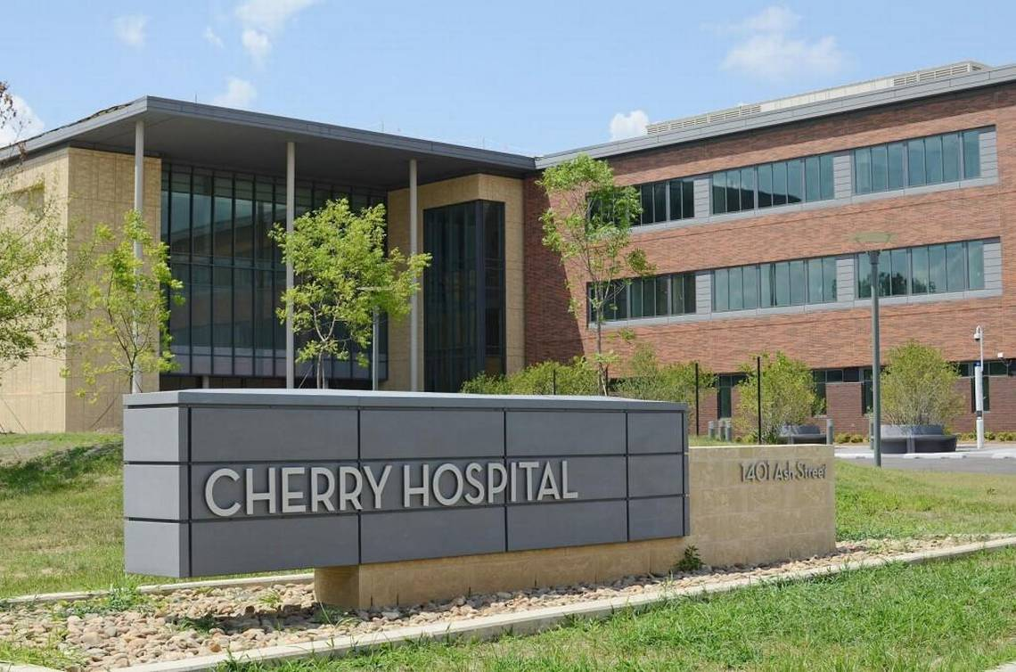
Cherry Hospital in Goldsboro, NC

Slide 8
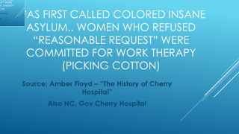

Was first called colored insane asylum.. Women who refused “reasonable request” were committed for work therapy (picking cotton)
Source: Amber Floyd – “The History of Cherry Hospital”
Also NC. Gov Cherry Hospital

Slide 9
What do we know about inequities in medical and Psychiatric treatment ?

Slide 10
Hispanics with bone fractures were less likely to receive pain medicine versus non Hispanic whites. (Hoffman 1994)

Slide 11
A 2000 study out of Emory University found that at a hospital emergency department in Atlanta, 74 percent of white patients with bone fractures received painkillers compared to 50 percent of black patients. Similar, a paper last year found that black children with appendicitis were less likely to receive pain medication than their white counterparts. And a 2007 study found that physicians were more likely to underestimate the pain of black patients compared with other patients.

Slide 12
African Americans are significantly less likely than Whites to receive guideline-appropriate depression care.
Several studies have shown that in real-world settings primary care physicians are less likely to detect, treat, refer, or actively manage depression in minority patients than in White patients.
African Americans are less likely than Whites to seek mental health care, accept recommendations to take antidepressants, or view counseling as an acceptable option.

Slide 13
"When you talk about mental illness in the black community, I think you have to begin with the experience of trauma and how trauma continues to abound in their experiences in their daily lives.“
~Dr. Michael Lindsey
mental health researcher and
associate professor at Silver School of Social Work
at NYU

Slide 14
Studies have shown that upper-class children can develop increased disturbance in various areas —
Substance use
Anxiety
Depression

Slide 15
WHY MIGHT “PRIVILEGED” YOUTH BE TROUBLED?
In exploring pathways to maladjustment in affluent suburbia, we considered two sets of potential antecedents in our study of Cohort II. The first encompassed achievement pressures. Statistical analyses showed, in fact, that children with very high perfectionist strivings—those who saw achievement failures as personal failures—had relatively high depression, anxiety, and substance use, as did those who indicated that their parents overemphasized their accomplishments, valuing them disproportionately more than their personal character (Luthar & Becker, 2002).
The second potential antecedent was isolation from adults, both literal and emotional. Among upper-middle-class families, secondary school students are often left home alone for several hours each week, with many parents believing that this promotes self-sufficiency.

Slide 16
2010 protest psychosis”

Slide 17


Slide 18
African Americans diagnosed with schizophrenia because of their civil rights ideas The second edition of the dsm changed the wording for schizophrenia to be hostile and aggressive

Slide 19
Bruce Levine oppositional defiant disorder which pathologizes anti authoritarian

Slide 20
Who is more likely to be diagnosed with odd?
Schizophrenia

Slide 21


Slide 22
Finally the use of anti psychotic medications in people not diagnosed with psychotic illness

Slide 23
5150 ca law hold based on law enforcement

Slide 24
Native Americans vary in their view of mental illness

Slide 25
Native Americans
k/ lack of access
ore serious Psychopathology/substance abuse PTSD than general population
Interventions must have traditional healing and 12 step programs

Slide 26
Views of psychiatry by African Americans

Slide 27
Psychiatric services march 1999 vol 50 no. 5
Carl bell md.
FM baker md, mph diagnostic bias with over diagnosis of schizophrenia

Slide 28
Maxie c. maultsby national council of Christian and Jews Harris poll
“black people are inferior academically and therefore have less mental capacity than white people”

Slide 29
Black patients, as well as native Americans, would prefer to see physicians/professionals of their own ethnicity.
This bring about disparity since these groups are severely underrepresented in the medical field.
- African American doctors make up approximately 5% of physicians
- Native American doctors make up less than 1% of physicians
African American patients are less trusting of physicians and their medical advice due to:
Dark history of experimentation (four-decade long Tuskegee syphilis study) = leads to mistrust, skepticism, = leads to decline in patients’ health
Religious stigma

Slide 30
Numerous studies have revealed that racial and ethnic and minority groups often receive different and less optimized management of their health care versus whites. (Journal of Law, Medicine Ethics 2001)

Slide 31
African American patients with psychotic disorders receive high doses of antipsychotic medication versus whites and are more likely to receive depot versus sga oral. (schizophrenia Research 2004)

Slide 32
Black patients are overly diagnosed with schizophrenia versus other groups (William Lawson MD, PhD; Netscape July 2012)

Slide 33
Bailey et all
2011
African Americans noted stigma religious beliefs distrust of medical professionals and medications 63% viewed depression a personal weakness. They are more likely to seek the help of clergy

Slide 34
Latinos: largest ethnic minority
Mexican
Puerto Ricans bilingual express more psychopathology

Slide 35
Latinos religion 90% catholic curandero folk heavily Mexican illness caused by evil forces-(evil eye)Psychoactive plants are used to induce visions to give answers to problems

Slide 36
Spiritism- Latin American and Caribbean karma- with the evil eye

Slide 37
Latinos prefer psychotherapy not medication as it raises the stigma of mental illness

Slide 38
Santeria- African and catholic beliefs- expels bad spirits, herbal medicines and people who intervene

Slide 39
Improving healthcare diversity

Slide 40
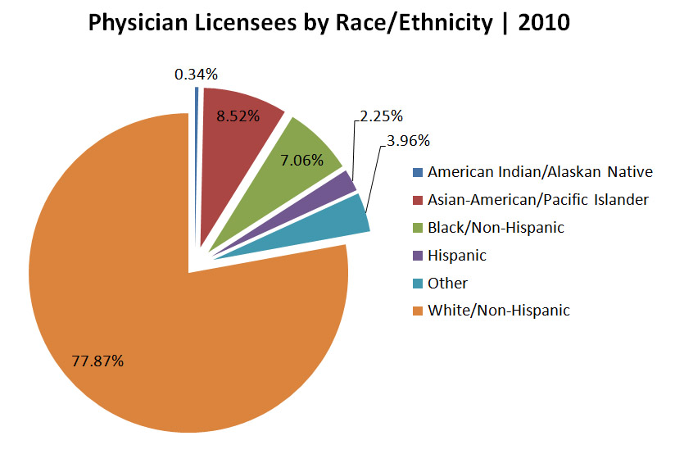

Slide 41
Offering education in cultural competence

Slide 42
Education to fight stigma

Slide 43
Diversity manager

Slide 44
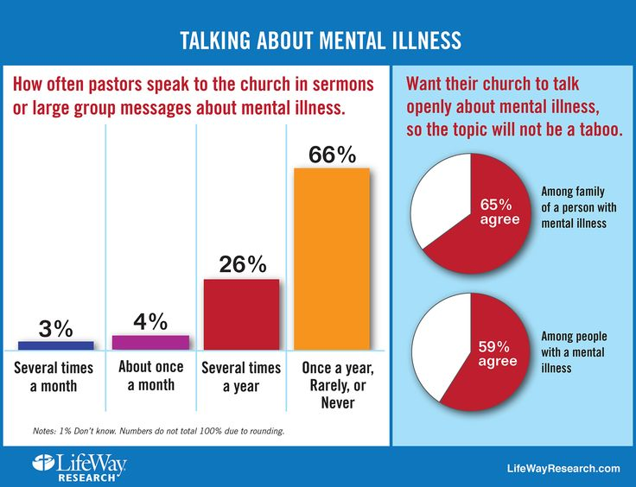

Slide 45
Solutions
Health resources and services administration found that minorities can improve access to care in underserved areas better than nonminorities
2010 Institute of medicine reports that a diverse workforce improves overall patient care by enhancing communication
Increase patient satisfaction
Decreases health disparity
Improves problem solving among the team

Slide 46


Slide 47
Bibliography ( no certain order)
Sullivan report 2004 “ diversity “
Institute of medicine report 2010
Health resources and Services Administration “ The Rational for Diversity “2009
“Issues in the Psychiatric treatment of African Americans” Baker, FM Bell ,carl Psychiatric services March 1999
Cultural perspectives on mental health” global mental health conference
Abdullah, mental illness stigma and ethnocultural beliefs Clinical Psychology 31: 934-938

Slide 48


Slide 49


Slide 50

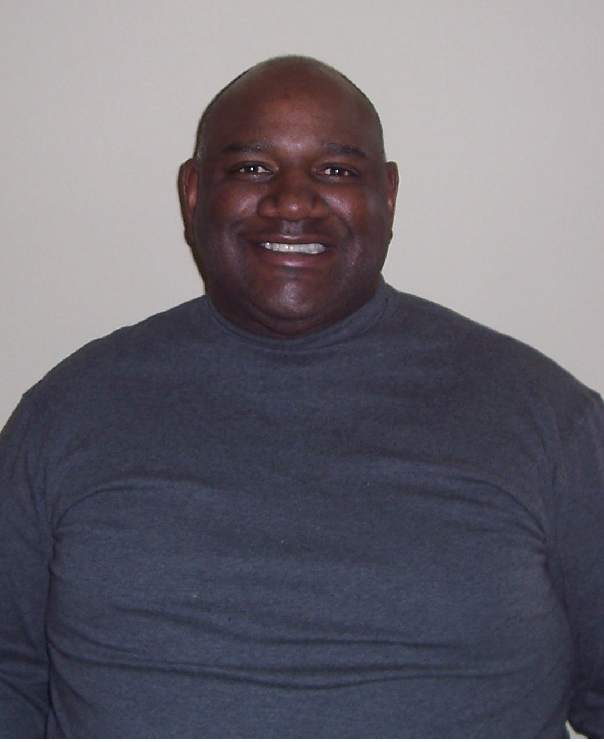

Dr. Maxie Gordon, Psychiatrist
East MS State Hospital
VA Medical Center
Hinds Behavioral Health
Ken Duckworth, M.D.
Medical Director, NAMI

Slide 51

Join us for our next webinar
Thursday, November 8, 4:00 – 5:30
Caregiving for People with Mental Illness
Grace Whiting, National Alliance on Caregiving
Sita Diehl, LAPSW

Slide 52
For additional information
www.nami.org

