Slide 1



Circle of Care: A Guidebook for Mental Health Caregivers
NAMI Ask the Expert Webinar
November 8, 2018
Grace Whiting, JD and Sita Diehl, MA, MSSW
Notes:
Sita introduce Rick

Slide 2



National Alliance for Caregiving
Non-profit coalition of over 60 national organizations focused on family caregiving issues
  2016 survey of 1601 mental health caregivers: Partnered with NAMI and MHA
  2016 report, On Pins and Needles: Caregivers of Adults with Mental Illness
  2018 Circle of Care: A Guidebook for Mental Health Caregivers in partnership with NAMI
Notes:
Rick

Slide 3
Sponsors
This research study, On Pins and Needles, was made possible through grant funding from:
Allergan
Eli Lilly
Janssen Scientific Affairs, LLC
Novartis Pharmaceuticals Corporation
Support for the Circle of Care Guidebook was made possible through grant funding from Alkermes.

Slide 4
Advisory Committee Members
This On Pins and Needles research was reviewed by an independent advisory committee:
Richard C. Baron, MA, Director of Knowledge Translation Activities, Temple University
Sita Diehl, Director of State Policy and Advocacy, National Alliance on Mental Illness
Tamar Heller, Ph.D., University of Illinois at Chicago
Karen Hirschman, Ph.D., University of Pennsylvania
Carol Levine, Director of Families and Health Care Project, United Hospital Fund
Victor Molinari, Ph.D., University of South Florida
Debbie Plotnick, MSS, MLSP, Vice President for Mental Health and Systems Advocacy, Mental Health America
Rosalyn Roker, MBA, MA, University of South Florida
Donna Wagner, Ph.D., New Mexico State University
Kelly Niles-Yokum, MPA, Ph.D., University of La Verne

Slide 5
The Big Picture:
8.4 million caregivers of adults with mental illness in U.S.
The Circle of Care Guidebook emerged from the NAC study of mental health caregivers in 2015/2016 in partnership with NAMI and MHA.
Respondent characteristics:
 | Mental Health | All Caregivers
Duration of care | 8.7 years | 4 years
Intensity of care | 32 hours/week | 24 hours/week
Caregiver Burden
Recipient financially dependent | 49%
Parent plan for future caregiving responsibility | 32%
Negative effect on caregiver health | 62%
Difficult to talk with others about issues | 48%
High emotional stress | 74%
See On Pins & Needles: Caregivers of Adults with Mental Illness, in partnership with NAMI and Mental Health America. Learn more at www.caregiving.org/research and Caregiving in the U.S. 2015, National Alliance for Caregiving and AARP Public Policy Institute
Notes:
GAIL
Might want to mention – study of Caregivers. Their feelings, thoughts, perceptions.

Slide 6
Who are the caregivers?
Most caregivers in sample were female (80%)
They usually are caring for a relative (88%)
Nearly half are caring for an adult son or daughter
Most are between the ages of 45 and 64 (average age is 54.3 years old)
65% had a college education or more advanced degree
46% had a household income of $75,000 or more
24% lived in rural areas
See On Pins & Needles: Caregivers of Adults with Mental Illness, in partnership with NAMI and Mental Health America. Learn more at www.caregiving.org/research.
Notes:
Rick
84% of the sample were white
1 in 7 care for a parent; 11% assist a spouse; 9% care for a sibling; and 9% assist a non-relative
Spend an average of 38.1 hours/week caring for relative
Higher that average US caregiver – 24.4 hours
Nearly all provide IADLs – transportation, shopping, preparation of meals, managing finances, giving medications, etc.
Only 18% assist with ADLs – bathing, toileting, transferring, etc. Perhaps due to the young age of the care recipients
Paucity of mental health professionals and treatment facilities in rural areas

Slide 7
Who are they caring for?
Average age is 46.3 years, most under 40
Almost half live in same household as caregiver (45%) or within 20 miles (27%)
Conditions Requiring Care
Bipolar disorder | 25%
Schizophrenia | 25%
Depression | 22%
Anxiety | 11%
Alcohol or drug abuse issue | 28%
See On Pins & Needles: Caregivers of Adults with Mental Illness, in partnership with NAMI and Mental Health America. Learn more at www.caregiving.org/research.
Notes:
Rck
37% 18 to 34 yrs; 21% 35 to 39 yrs

Slide 8
Challenges: Caregiver perspective
Diagnosis: 11.8 years on average to arrive at an accurate diagnosis. 39% think diagnosis may be incorrect
Care planning: 55% feel excluded from communication with mental health care providers
Hospital discharge: 70% feel the recipient was discharged too quickly at some point
Financial dependence: 49% report the recipient is partly or fully financially dependent on family & friends
Future planning: Only 32% had plan if they can no longer provide care. Only 35% can rely on other family
Other challenges: Provider shortage, insurance barriers, self-harm, arrest, homelessness, stigma, self-care
Friends and family wanted a guidebook to help navigate these challenges
See On Pins & Needles: Caregivers of Adults with Mental Illness, in partnership with NAMI and Mental Health America. Learn more at www.caregiving.org/research.
Notes:
LISA
{FIRST BULLET if needed} Caregivers of those with substance abuse issues (59% vs. 20% no substance abuse), caregivers of those with schizophrenia or bipolar disorder (43% vs. 15% of those with depression or anxiety), and those caring for males (45% vs. 19% female) more often report their loved one having been arrested
{LAST BULLET} 65% concerned about attempts to die by suicide; 68% fear their loved one will hurt themselves. Another major concern among mental health caregivers is victimization – 50% worry that their loved one will be hurt by someone else. The younger the care recipient, the more often the caregiver is concerned about suicide (FIGURE 26 in report – 81% among 18-34 year old recipients dropping to 40% among those 65+)

Slide 9
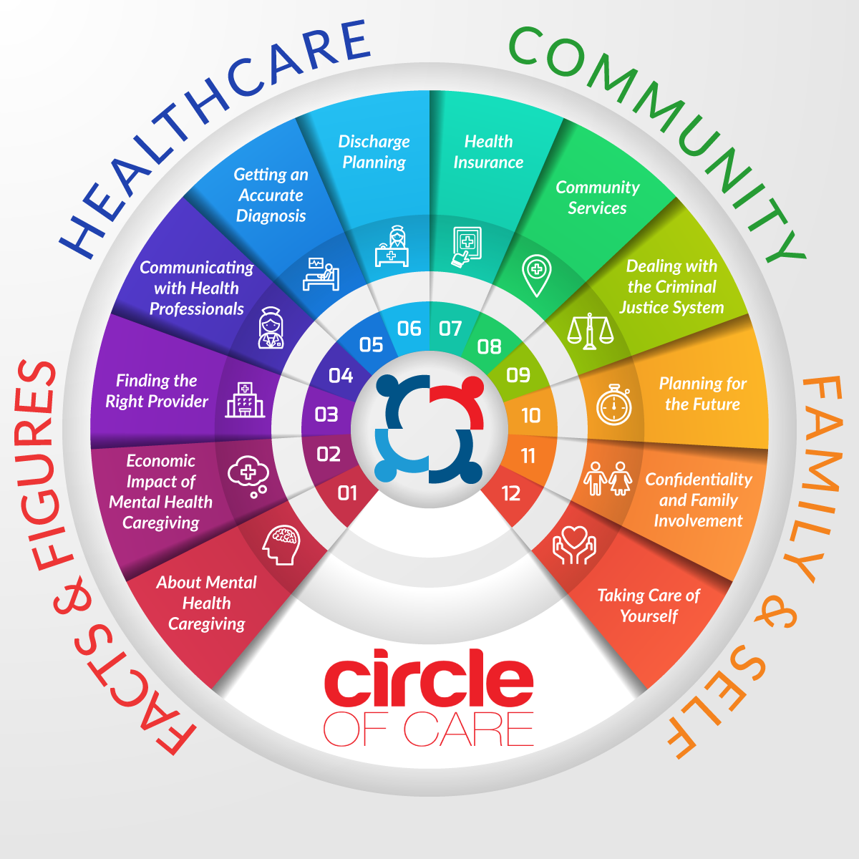
Circle of Care Mental Health Guidebook
www.caregiving.org/circleofcare

Slide 10
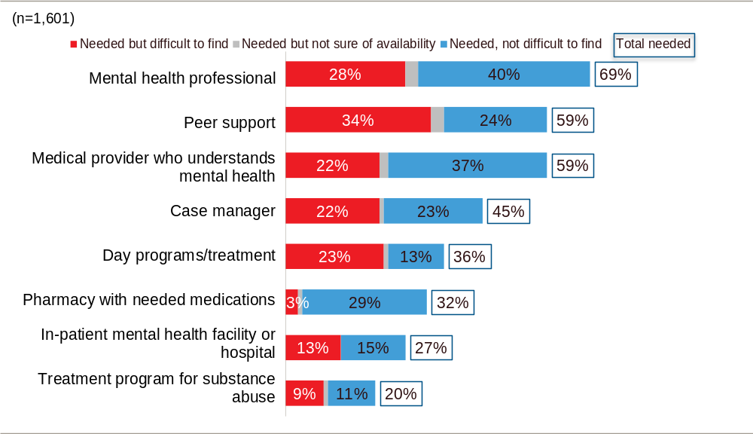
Challenge: Service needs vs. availability
See On Pins & Needles: Caregivers of Adults with Mental Illness, in partnership with NAMI and Mental Health America. Learn more at www.caregiving.org/research.
Notes:
Almost seven in ten say their loved one needs a mental health professional (69%), while six in ten feel their care recipient needs peer support (59%) or a medical provider who understands his/her mental health issues (59%). About half feel their loved one needs a case manager (45%). One in three report their care recipient needs day programs or treatment (36%) and a pharmacy that has needed medications (32%). Fewer say the adult they care for needs in-patient treatment (27%) or substance abuse treatment (20%).

Slide 11
Quotes: Service needs
“We need services within my county. We have to travel 80+ miles round trip for a psychiatrist visit of 5 minutes.”
“There should be a mentor type person available for my son on a regular basis so I'm not the person who must always be "ON-CALL" 24/7; someone to teach him how to cook, balance a checkbook and clean his apartment.”
Notes:
Sita: Read examples
How many people have had the experience with yourself or a loved one being turned away from the ER or discharged from hospital too soon?

Slide 12
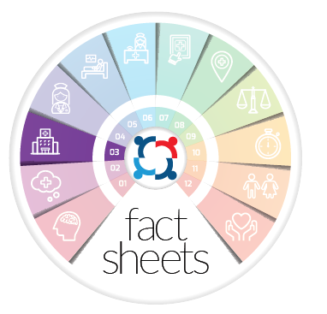
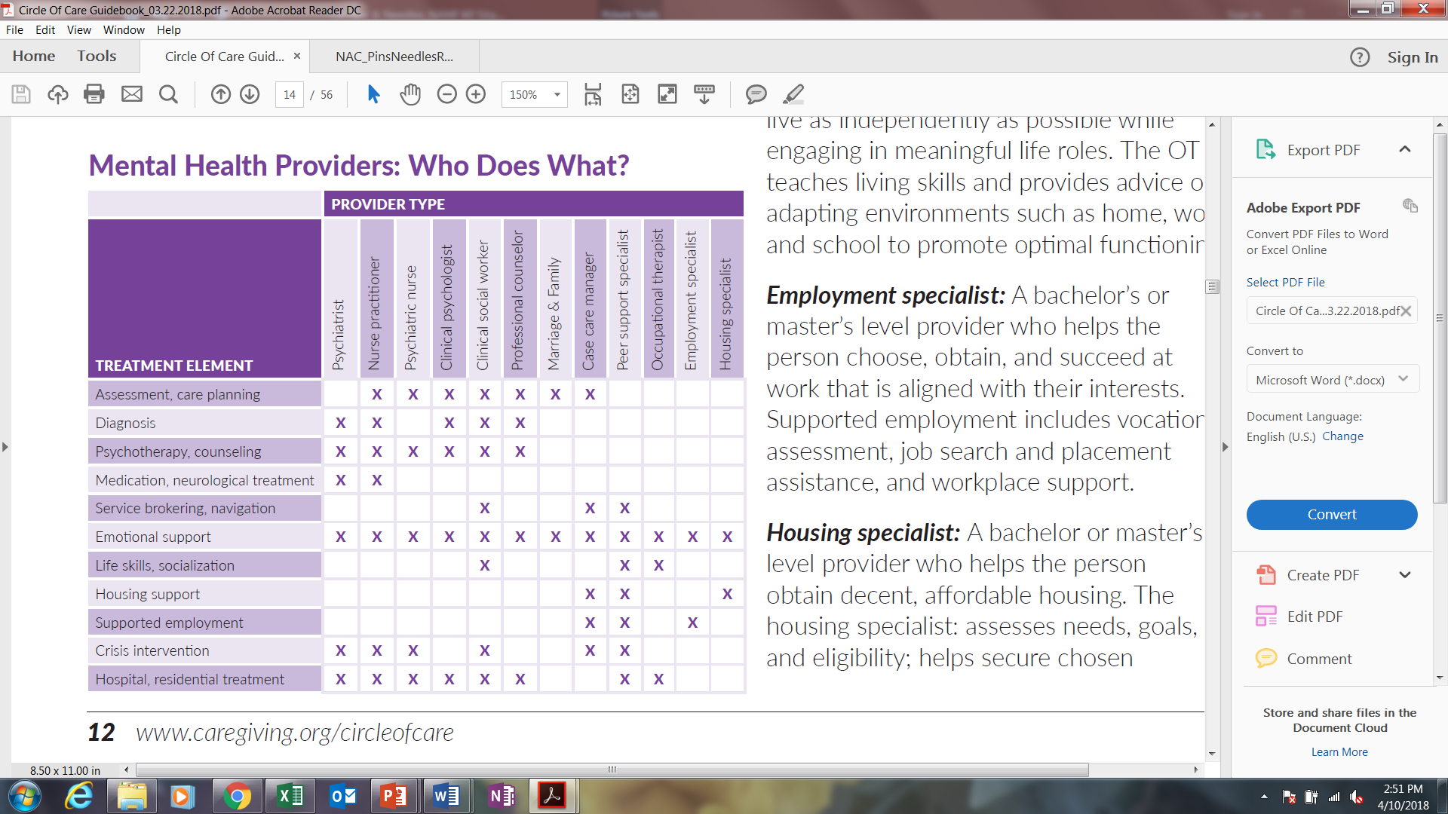
Fact sheet 03: Finding the Right Provider
Need: Mental health provider shortage
  69% felt recipient needed a professional
  28% difficulty finding a local provider
Types of mental health providers
Questions to ask when seeking a provider
Caregiver role in promoting quality care
www.caregiving.org/circleofcare
Notes:
These caregiver responses echo the frustration that many patients feel when attempting to diagnosis and treat mental illness.
Here is how one respondent expressed it:
“
Show of hands, how long from first symptoms to diagnosis for you or your loved one?
Less than 6 months
6 months - 1 year
1 – 3 years
4 – 6 years
7 – 10 years
11 – 15 years
16 years or more
More than 10 years

Slide 13
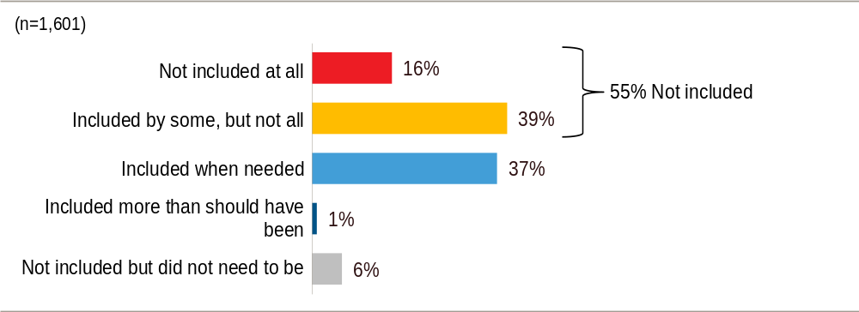
Challenge: Caregivers excluded from communication with mental health providers
See On Pins & Needles: Caregivers of Adults with Mental Illness, in partnership with NAMI and Mental Health America. Learn more at www.caregiving.org/research.
Notes:
Sita
Caregivers *perception* of exclusion – need further research to figure out why
To what extent do/did you feel care providers have/had included you in
conversations about your [relation]’s care?
What was your experience with being excluded or included or excluded in care planning, support and follow up?

Slide 14
Quote: Caregivers excluded from communicate with mental health providers
“Caregivers are often overlooked and the importance of the role they play in the wellness of their loved one is underestimated. An educated, healthy and supported caregiver is critical. The need for MH services is first and foremost, yet families also need their own support in the community.”
Notes:
Sita: What was your experience with being excluded or included or excluded in care planning, support and follow up?
Take one or two responses.

Slide 15
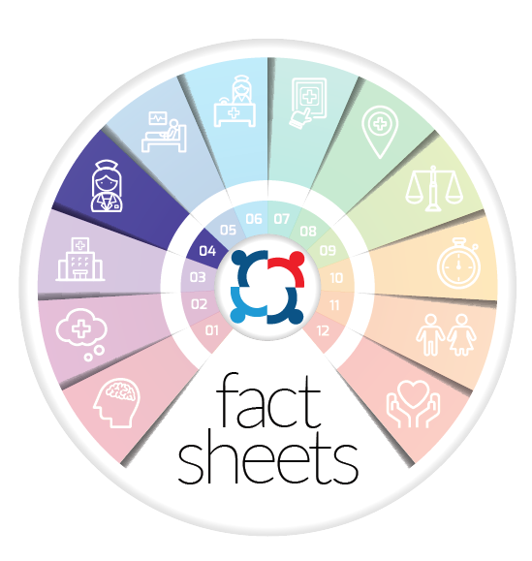

Fact sheet 04: Communicating with Health Professionals
How federal law protects/permits communication
Communication planning:
  What will be communicated, how & when?
  Discuss with recipient in person-centered way
    Consent to release information
  Meet with provider to discuss conditions
Record keeping to:
  Provide accurate, useful information
  Promote continuity of care
www.caregiving.org/circleofcare
Notes:
These caregiver responses echo the frustration that many patients feel when attempting to diagnosis and treat mental illness.
Here is how one respondent expressed it:
“
Show of hands, how long from first symptoms to diagnosis for you or your loved one?
Less than 6 months
6 months - 1 year
1 – 3 years
4 – 6 years
7 – 10 years
11 – 15 years
16 years or more
More than 10 years

Slide 16
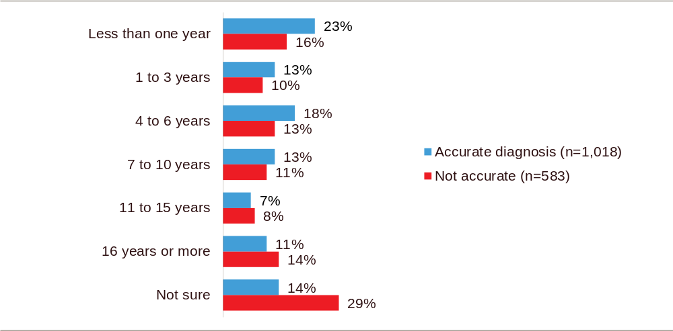
Challenge: Time to Diagnosis
Where the recipient has an accurate diagnosis, it took average of 11.8 years to achieve
39% did not think or weren’t sure the diagnosis was correct
See On Pins & Needles: Caregivers of Adults with Mental Illness, in partnership with NAMI and Mental Health America. Learn more at www.caregiving.org/research.
Notes:
Sita
About four in ten mental health caregivers do not think (20%) or are not sure (19%) that their recipient’s mental health issues have been diagnosed accurately. (RED BARS – show how long caregivers say their loved one continues to search for diagnosis)
While 62% of mental health caregivers do believe their loved one’s mental health issues have been accurately diagnosed (blue bars), it took an average of 11.8 years to get that diagnosis.

Slide 17
“He developed schizophrenia in his early teens. It took years for anyone to make the correct diagnosis, despite the fact that I paid out of pocket for multiple evaluations.
We were only fortunate enough to get help when I asked a friend, a psychiatrist, to find someone for my son. We were referred to a resident who was wonderful and helped us to deal with the diagnosis. She is now in private practice and still sees my son at a reduced rate.”
Quote:
Time to Diagnosis
Notes:
These caregiver responses echo the frustration that many patients feel when attempting to diagnosis and treat mental illness.
Here is how one respondent expressed it:
“
Show of hands, how long from first symptoms to diagnosis for you or your loved one?
Less than 6 months
6 months - 1 year
1 – 3 years
4 – 6 years
7 – 10 years
11 – 15 years
16 years or more
More than 10 years

Slide 18

Fact sheet 05: Getting an accurate diagnosis
Purpose of diagnosis
Who can diagnose:
  Types of prescribers
  Types of counselors
Diagnostic process
What if the diagnosis doesn’t seem right?
How caregivers can help improve accuracy
www.caregiving.org/circleofcare
Notes:
These caregiver responses echo the frustration that many patients feel when attempting to diagnosis and treat mental illness.
Here is how one respondent expressed it:
“
Show of hands, how long from first symptoms to diagnosis for you or your loved one?
Less than 6 months
6 months - 1 year
1 – 3 years
4 – 6 years
7 – 10 years
11 – 15 years
16 years or more
More than 10 years

Slide 19
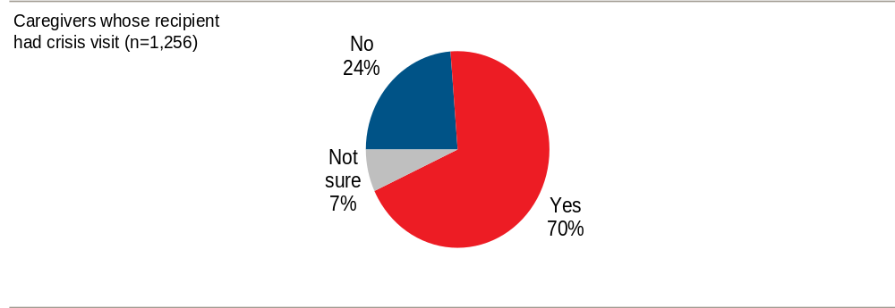
Challenge: Care recipients discharged prematurely
If your relation went to an emergency room, hospital, or other facility due to an urgent mental health issue, do you feel he or she was ever sent home too early or too quickly?
Notes:
Seven in ten caregivers report that their loved one has ever gone to an emergency room, hospital, or other facility due to an urgent or crisis mental health situation (70%). Among those who report their loved one has gone to a facility in crisis, 70% feel their loved one was sent home too early or quickly (chart on screen).
Therefore -- among all mental health caregivers, 49% say their loved one has gone to a facility in a mental health crisis situation, only to be discharged too soon.

Slide 20
“My son was often discharged from the hospital before he was stable on medicine.”
“We have been turned away from local hospitals twice while my son was psychotic and seeking help, because there was no psychiatrist on staff and no available beds. At one hospital a staff member advised me to take my son home and call police if he got worse. This was terribly inappropriate for a medical problem.”
Quotes:
Care recipients discharged prematurely
Notes:
Sita: Read examples
How many people have had the experience with yourself or a loved one being turned away from the ER or discharged from hospital too soon?

Slide 21

Fact sheet 06: Hospital Discharge Planning
Psychiatric crisis and inpatient care
Hospital discharge
Caregiver role in transition
Services and supports
Recipient self-care
Recovery and support
Caregiver health
www.caregiving.org/circleofcare
Notes:
These caregiver responses echo the frustration that many patients feel when attempting to diagnosis and treat mental illness.
Here is how one respondent expressed it:
“
Show of hands, how long from first symptoms to diagnosis for you or your loved one?
Less than 6 months
6 months - 1 year
1 – 3 years
4 – 6 years
7 – 10 years
11 – 15 years
16 years or more
More than 10 years

Slide 22
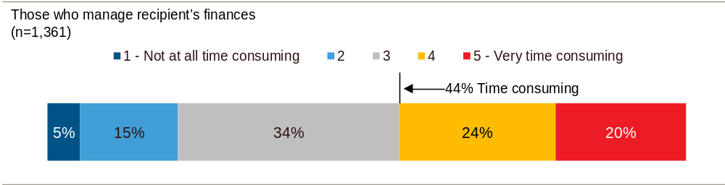
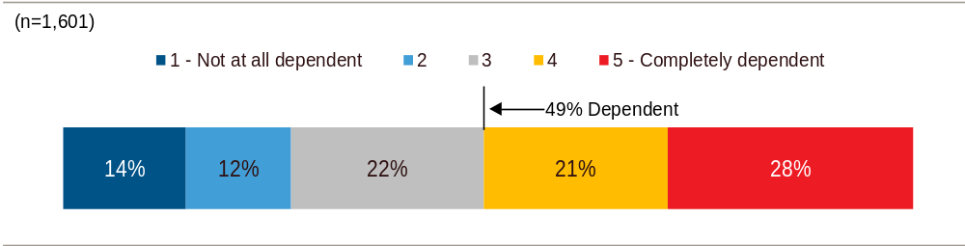
Challenge: The “business of care”
How time consuming is/was it for you to help with paperwork or finances?
How financially dependent is the recipient on family or friends?
Notes:
Navigating the healthcare system in the United States is often difficult, but the patchwork and disparate mental health system can require caregivers to actively manage the “business of care.” Eight in ten mental health caregivers help their loved one manage his or her finances or paperwork, helping with forms, bills, payments, or health insurance (82%). Of those who assist with this {TOP GRAPH} , 44% find it time consuming.
Half of mental health caregivers say their care recipient is financially dependent (completely or significantly) on family or friends (49% rating 4 or 5 on a 5-point scale). {BOTTOM GRAPH}

Slide 23
Quote:
The “business of care”
“We have always found support for our daughter but it isn't always covered by insurance. This is an expensive journey. We feel lucky but financially stressed. I lost my job in December and my husband's insurance that we have now is really awful.
I do wish there was an patient navigator who could help us understand more about Medicaid options…Social Security benefits…living options, creating wills and estate and trust planning to support her properly when we can’t.”

Slide 24

Fact sheet 07: Health Insurance
Insurance and mental health
Federal mental health parity laws
Parity warning signs
What to do:
  Discuss with provider
  Call health plan customer service
  File an appeal
  Contact government agency
www.caregiving.org/circleofcare
Notes:
These caregiver responses echo the frustration that many patients feel when attempting to diagnosis and treat mental illness.
Here is how one respondent expressed it:
“
Show of hands, how long from first symptoms to diagnosis for you or your loved one?
Less than 6 months
6 months - 1 year
1 – 3 years
4 – 6 years
7 – 10 years
11 – 15 years
16 years or more
More than 10 years

Slide 25


Fact sheet 10: Planning for the Future
What is future planning?
Components
  Benefits and financial planning
  Residential planning
  Support networks
Taking the first step
  Emotional barriers
  Service system barriers
  Complexity of legal/financial planning
Notes:
Similar to caregivers of adult children with intellectual disabilities
These parents are especially vulnerable; 60 years old and have been providing care for 29 hours/week for 14 years

Slide 26
Challenge: Dealing with the Criminal Justice System
Arrest
Recipient had been arrested | 32%
Arrest x substance use disorders | 59% SUD | 20% No SUD
Arrest x psychosis vs. depression/anxiety | 43% psychosis | 15% no psychosis
Arrest x gender | 45% male | 19% female
Notes:
{FIRST BULLET if needed} Caregivers of those with substance abuse issues (59% vs. 20% no substance abuse), caregivers of those with schizophrenia or bipolar disorder (43% vs. 15% of those with depression or anxiety), and those caring for males (45% vs. 19% female) more often report their loved one having been arrested
{LAST BULLET} 65% concerned about attempts to die by suicide; 68% fear their loved one will hurt themselves. Another major concern among mental health caregivers is victimization – 50% worry that their loved one will be hurt by someone else. The younger the care recipient, the more often the caregiver is concerned about suicide (FIGURE 26 in report – 81% among 18-34 year old recipients dropping to 40% among those 65+)

Slide 27
Quote:
Dealing with the criminal justice system
“The last year was a nightmare having my son hospitalized three times back to back mainly because he was not stable enough when released from the hospital.
The finale was his being arrested for first degree burglary when in fact he was under the delusion that he was suppose to clean someone's house. Eventually, the charge was reduced, but am still dealing with the legal system.
It would have been nice to have someone to turn to while all this was happening.”

Slide 28

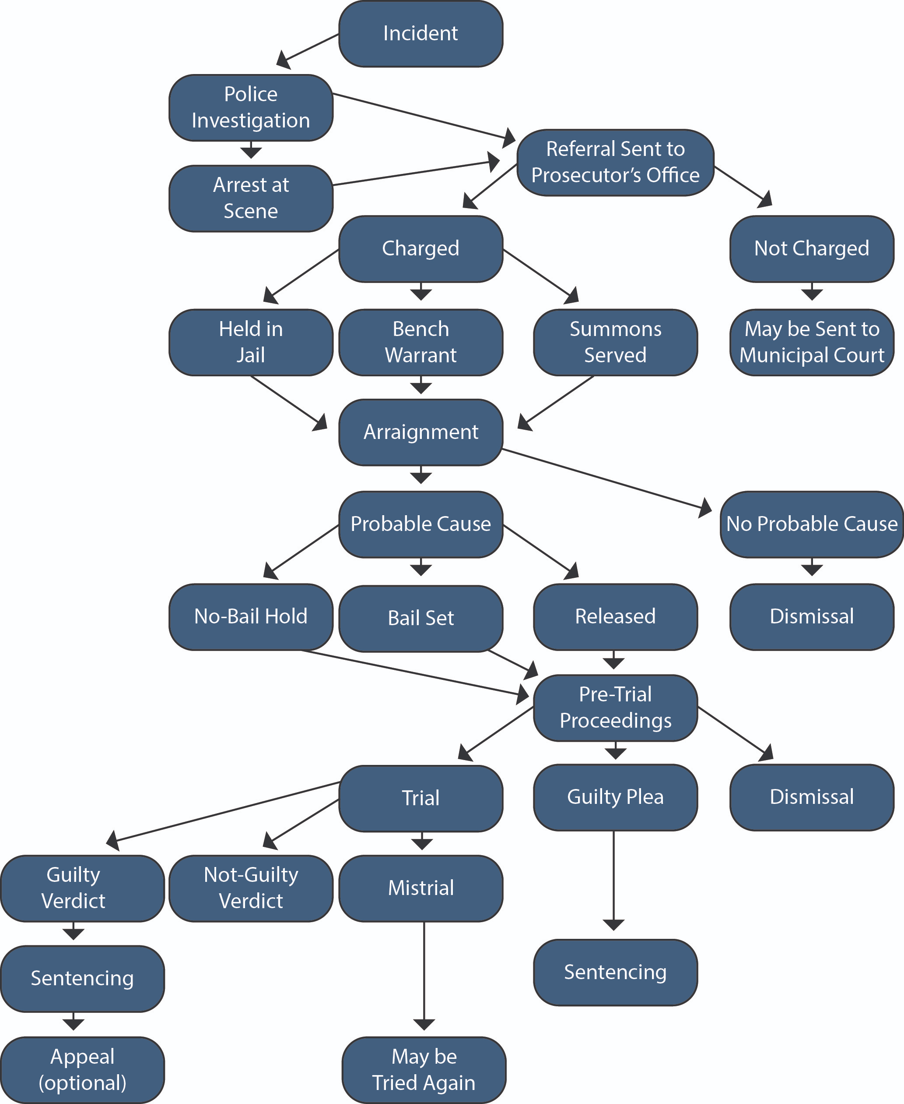
Fact sheet 09: Dealing with the Criminal Justice System
Criminalization of mental illness
Criminal justice process:
  Crisis
  Arrest
  Court
  Incarceration
  Release
Caregiver tips
www.caregiving.org/circleofcare
Notes:
These caregiver responses echo the frustration that many patients feel when attempting to diagnosis and treat mental illness.
Here is how one respondent expressed it:
“
Show of hands, how long from first symptoms to diagnosis for you or your loved one?
Less than 6 months
6 months - 1 year
1 – 3 years
4 – 6 years
7 – 10 years
11 – 15 years
16 years or more
More than 10 years

Slide 29
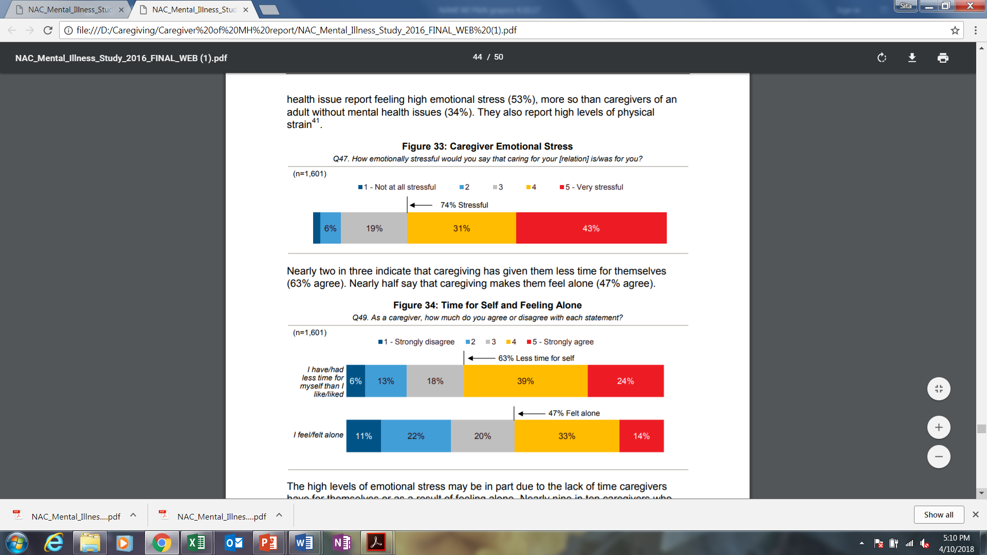
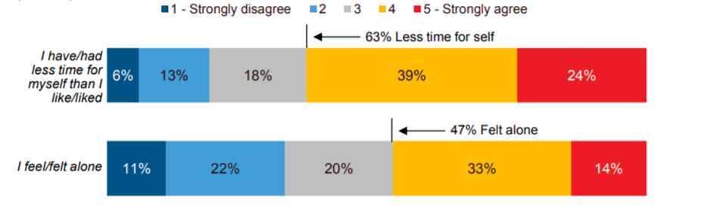
Challenge: Caregiver Self-care
  How emotionally stressful was caring for your relative?

Slide 30
Quotes:
Caregiver Strain
“My life has been turned upside down with the illnesses of our sons. We have lost hours and hours of sleep, we have been under tremendous stress, we have spent countless hours trying to find help for the boys. I have had to navigate my way through lots of financial issues and health insurance problems. There is little support for us in the community. It has been an education that I wish I did not have to experience.
“My physical health has declined dramatically in the last year, including several emergency room visits. All of my doctors have agreed that stress is the cause of my problems. The chronic stress of caring for a mentally ill adult son is unbearable.”

Slide 31


Fact sheet 12: Taking Care of Yourself
Mental health caregiver stress
What you can do
  Caregiver health self-assessment
    Physical health
    Spiritual health
    Emotional health
    Financial health
Resources
www.caregiving.org/circleofcare
Notes:
These caregiver responses echo the frustration that many patients feel when attempting to diagnosis and treat mental illness.
Here is how one respondent expressed it:
“
Show of hands, how long from first symptoms to diagnosis for you or your loved one?
Less than 6 months
6 months - 1 year
1 – 3 years
4 – 6 years
7 – 10 years
11 – 15 years
16 years or more
More than 10 years

Slide 32
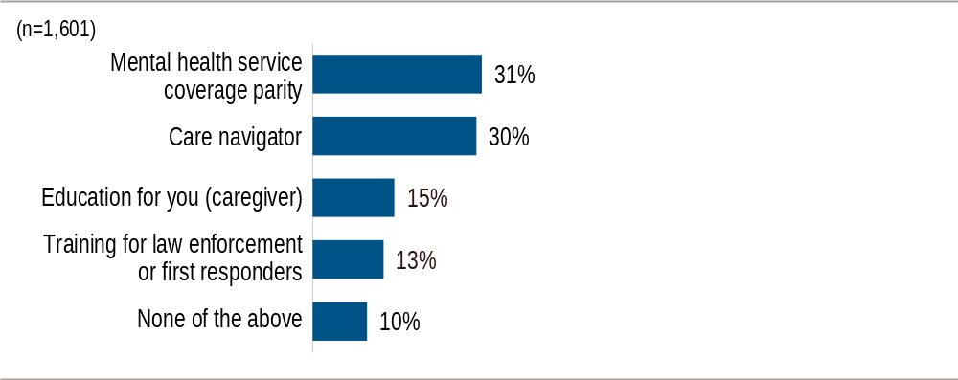
What policy solutions would best help family caregivers?
Figure 18: Which of the following policies or programs would be most helpful to you as a caregiver?
Notes:
When asked to select ONE policy or program that would have been most helpful, The two most helpful policies accordingly to mental health caregivers involve help with accessing services and navigating the care system. Three in ten say it would be helpful to have health insurance plans to cover mental illness at similar levels as they cover medical care (31%, “parity” item in the chart), while 30% would most prefer a care navigator to help figure out the mental health care system and service providers.
If asked/needed:
Despite recent legislation such as the Patient Protection and Affordable Care Act of 2010, caregivers still perceive mental health service coverage parity to be lacking. Further research is needed to determine why and how caregivers experience coverage issues related to mental and behavioral health services for their loved ones. Possible explanations could include that: care recipients are not insured, recipients are insured but through non-parity legislated plans, caregivers and/or care recipients do not understand the level of coverage in their insurance plans, or caregivers want greater service access rather than coverage equity.
“PPACA expands the reach of federal mental health parity requirements to three main types of health plans: qualified health plans as established by the ACA; Medicaid non-managed care benchmark and benchmark-equivalent plans; and plans offered through the individual market.” Sarata, Amanda K. “Mental Health Parity and the Patient Protection and Affordable Care Act of 2010”. Congressional Research Office. December 28, 2011. http://www.ncsl.org/documents/health/MHparity&mandates.pdf

Slide 33
Public Policy Solutions
Navigate
Federal, state and local government support for caregivers and recipients in navigating the mental health system.
Include
Include caregivers as part of the health care team.
Educate
Educate caregivers of people with mental illness, especially around issues of stress and caregiver health.

Slide 34
Public Policy
Solutions
Assist with navigation
  SAMHSA helpline & treatment locator
    21st Century Cures Act
  Boundary spanners: school, justice, housing…
  Nonprofit mental health helplines
Include caregivers in the care team
  Health privacy education: providers, lawyers, care recipients, caregivers
    21st Century Cures Act
  Include caregivers in hospital discharge planning
    CARE Act, state legislation
Educate/provide resources to caregivers
  National Family Caregiver Support Program for mental health caregivers (not yet proposed)
    Support for caregiver mutual education and support programs
Notes:
Acknowledges challenges:
Growing population of aging caregivers caring for adult children with mental health needs
What is future planning
Person centered
Involve others in Circle of Support
Not a one-time event
Components
Benefits and financial planning
Special needs trusts
Pooled trusts
ABLE accounts
Residential planning
Support networks
Care coordination
Decision making supports
Instrumental supports
Taking the first step
Emotional barriers
Service system barriers
Complexity of legal/financial planning
Resources

Slide 35

Promising National Momentum
National/Federal Strategy:
RAISE Family Caregivers Act (2018) (P.L.115-119)
  Need to act quickly – the act will sunset in 2021!
  Opportunities for state plans to take leadership
  Currently open for nominations to the Advisory Committee
V.A. MISSION Act (2018) (P.L. 115-182)
  Expands the VA Caregiver Support program, which includes support for caregivers of Vets with mental illness AND a behavioral health benefit for the caregiver
Federal Regulatory Interest:
FDA interest in caregiver’s role in patient-focused drug and medical product development
CMS Billing Codes to assess caregiver depression ((Code 96161, “Administration of caregiver-focused health risk assessment instrument (e.g., depression inventory) for the benefit of the patient, with scoring and documentation, per standardized instrument.”)
RAISE Nomination: https://www.federalregister.gov/documents/2018/10/12/2018-22268/solicitation-for-nominations-to-serve-on-the-family-caregiving-advisory-council
VA Caregiver Support Program: https://www.caregiver.va.gov/

Slide 36
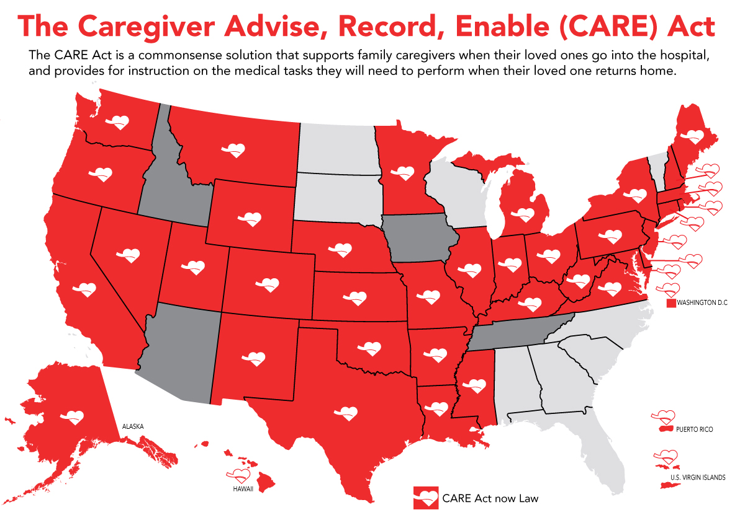
AARP state bill:
CARE Act
Caregiver Advise, Record, Enable
Designate: Family caregiver name is recorded upon admission to hospital or rehab
Notify: The family caregiver notified if relation is to be discharged
Educate: The hospital or rehabilitation facility must provide an explanation and live instruction of caregiver tasks.
Learn more at https://states.aarp.org/family-caregivers-and-the-care-act

Slide 37
Mental Health Caregiver Resources:
National Alliance for Caregiving
Research, such as:
Guidebook:
www.caregiving.org/mentalhealth
www.caregiving.org/circleofcare

Slide 38



Sita Diehl, LAPSW
C. Grace Whiting, J.D.
President & CEO
National Alliance for Caregiving
Teri Brister, PhD
Director Information & Support , NAMI

Slide 39
Join us for our 2019 webinar series
  Cognitive Behavioral Therapy (CBT) for people with psychosis
  The All of Us project
  The Effectiveness of the NAMI Homefront program
  The Importance of incorporating evidence based practices into treatment

