Slide 1

Mental Health America’s
Center for Peer Support
Master Class Series

Slide 2
Trauma Informed Peer Support and the Impact of Social Determinants
Patrick Hendry

Slide 3
Social Determinants of Mental Health
Mental health and many common mental health disorders are shaped to a great extent by the social, economic, and physical environments in which people live.
Social inequalities are associated with increased risk of mental health problems and other serious health conditions.
World Health Organization
(WHO)

Slide 4
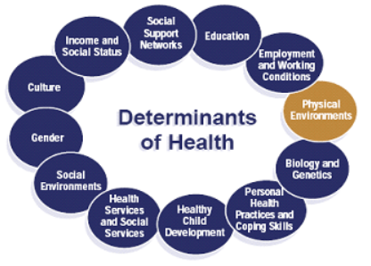
Social Determinants of Health
Taking action to improve the conditions of daily life provides opportunities to improve mental and physical health and reduce the risk of the disorders associated with social inequalities.
WHO

Slide 5
Social Determinants of
Mental Health
While comprehensive action throughout a persons life is needed, scientific consensus is considerable that giving every child the best possible start will generate the greatest societal and mental health benefits.
Action needs to take place across the whole of society, proportionate to need in order to level the social field in health outcomes.
WHO

Slide 6
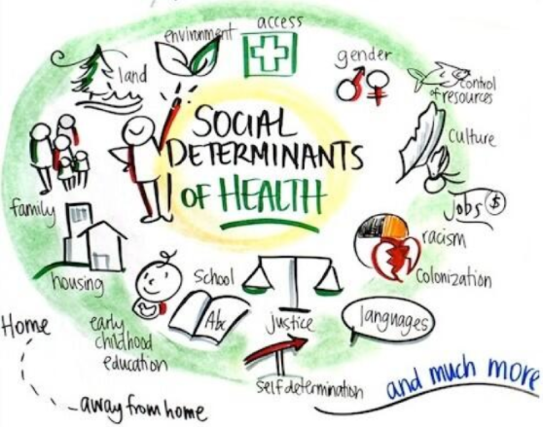
Social Determinants of Mental Health
There is a considerable need to raise the priority given to the prevention of mental disorders
and to the
promotion of
mental health
through action
on the social
determinants of
health.

Slide 7

Social Determinants
Name 5 of the Social Determinants of Health.
Which determinants have the greatest effect on mental health?

Slide 8
Discussion: Social Determinants of Mental Health
“What role can peer support and the peer community play in changing the social determinants that have negative effects on individuals mental health?”

Slide 9
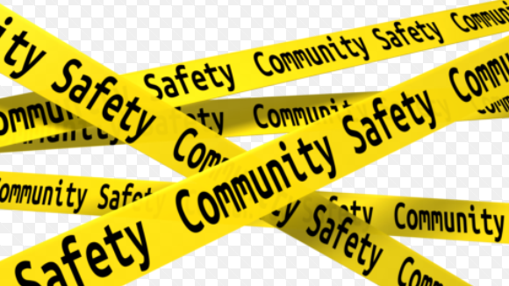
The Impact of Trauma
Essential to mental and physical health is safety.
The feeling of safety in your environment and in your relationships is a social determinant with broad consequences.
When our safety is violated we experience trauma.

Slide 10
The Impact of Trauma
Trauma, including one-time, multiple, or long-lasting repetitive events, affects everyone differently. The impact of trauma can be subtle, insidious, or outright destructive.
How an event affects an individual depends on many factors, including characteristics of the individual, the type and characteristics of the event(s), developmental processes, the meaning of the trauma, and sociocultural factors.

Slide 11
The Effects of ACEs
Adverse childhood experiences (ACEs) are stressful or traumatic events, including abuse and neglect. They may also include household dysfunction such as witnessing domestic violence or growing up with family members who have substance use disorders.
ACEs are strongly related to the development and prevalence of a wide range of health problems throughout a person’s lifespan, including those associated with substance misuse SAMHSA

Slide 12
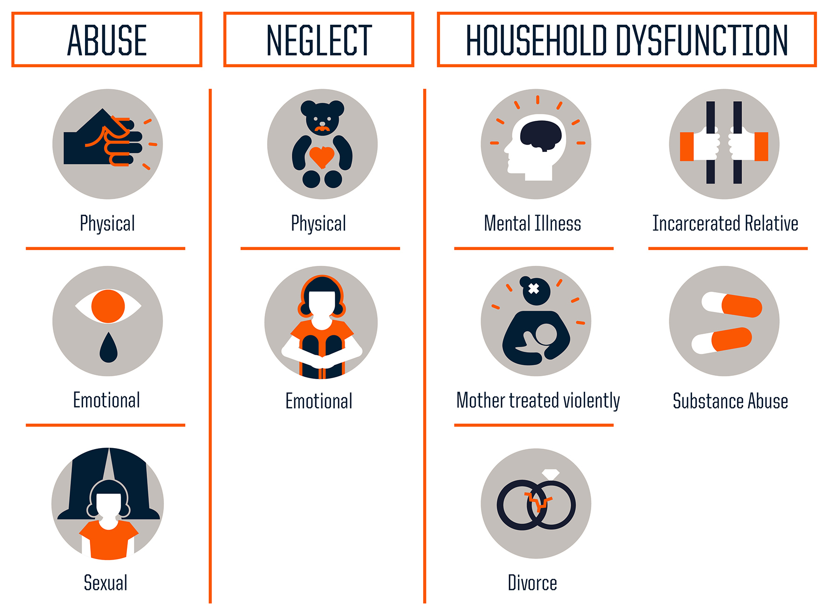
Three Types of ACEs
Adverse Childhood Events
Source: Centers for Disease Control and Prevention
Credit: Robert Wood Johnson Foundation

Slide 13
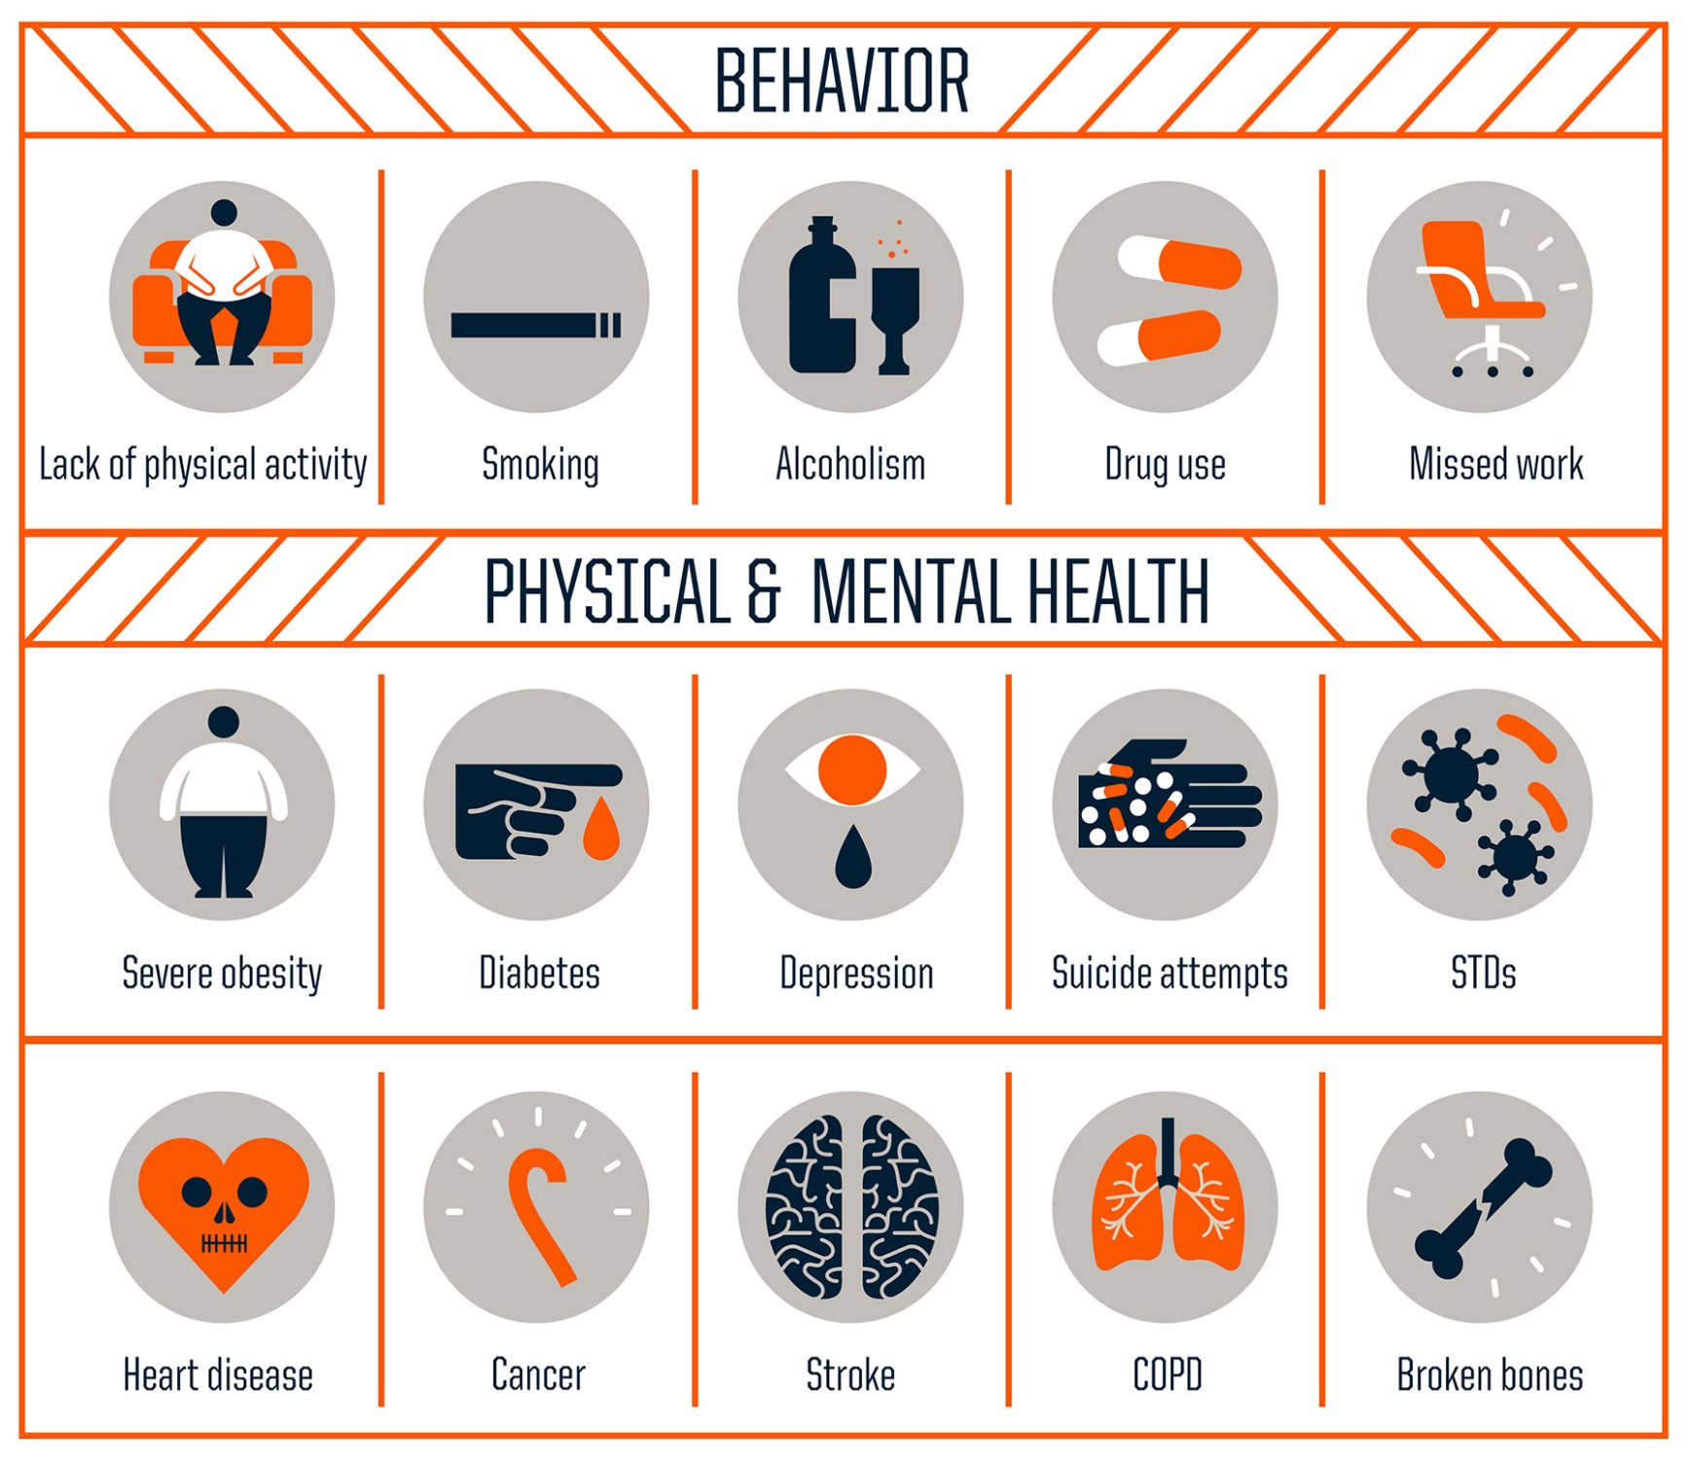
CEs Increase Health Risks
According to the Adverse Childhood Experiences study, the rougher your childhood, the higher your score is likely to be and the higher your risk for various health problems later.
Source: Centers for Disease Control and Prevention
Credit: Robert Wood Johnson Foundation
Effects of
ACE’s

Slide 14

Initial Impact of Trauma
Initial reactions to trauma can include:
exhaustion,
confusion,
sadness,
anxiety,
agitation,
numbness,
dissociation,
physical arousal, and
blunted affect.
Most responses are normal in that they affect most survivors and are socially acceptable, psychologically effective, and self-limited.

Slide 15

Severe Impact of Trauma
Indicators of more severe responses include:
  Continuous distress without periods of relative calm or rest;
  Severe dissociative symptoms; and
  Intense intrusive recollections that continue despite a return to safety.

Slide 16
Delayed Impact of Trauma
Delayed responses to trauma can include:
persistent fatigue;
sleep disorders, nightmares;
fear of recurrence;
anxiety focused on flashbacks;
depression, and avoidance of emotions;
sensations, or activities that are associated with the trauma, even remotely.

Slide 17
The Impact of Trauma
A trauma-informed approach reflects adherence to six key principles rather than a prescribed set of practices or procedures.
  Safety
  Trustworthiness and Transparency
  Peer Support
  Collaboration and mutuality
  Empowerment, voice and choice
  Awareness of Cultural, Historical, and Gender Issues

Slide 18
Discuss the following as it applies to trauma informed peer support:
  Safety
  Trustworthiness and Transparency
  Peer Support
  Collaboration and mutuality
  Empowerment, voice and choice
  Awareness of Cultural, Historical, and Gender Issues

Slide 19
Trauma Informed Peer Support Practices
Builds on shared experience and mutual exchange
Eliminates the power differential inherent in traditional mental health settings/clinical relationships
Provides for reciprocal receiving and giving of support:
Fosters relationships that establish new ways of understanding their experience – not as clinical pathology rather as understandable reactions to trauma.
Shery Mead 2008

Slide 20
Trauma Informed Peer Support Practices
Utilize an Empowerment Model
Have an understanding of the role of trauma in people’s lives
Facilitate healing
Respect Voice and Choice
Work in a collaborative way with mutual goals
Minimize re-traumatization
Meet people where they are
Understand adaptive behaviors as strengths with a purpose
Shery Mead

Slide 21
Essential Qualities for Working with People who have experienced Trauma
  Empathy
  Compassion
  Ability to talk openly and honestly
  Self-awareness
  Flexibility
  Comfortability with the unknown
  Willingness to learn
  Willingness to emotionally connect
  Ability to treat folks as equals
  Mutuality and Collaboration
  Self-care
  Doing your own emotional work
  Centre for Excellence in Peer Support

Slide 22
Connection Vs Disconnection
“When you speak to me about your deepest question, you do not want to be fixed or saved: you want to be seen and heard, to have your truth acknowledged and honored. If your problem is soul deep, your soul alone knows what you need to do about it, and my presumptuous advice will only drive your soul back into the wood.”
Parker Palmer
Centre for Excellence in Peer Support

Slide 23

Things Peer Supporters Might Do That Cause Disconnection
Ordering or directing
Cautioning
Arguing or lecturing
Being unaware of your own power
Over relating
Interpreting or analyzing
Reassuring or sympathizing
Questioning or probing
Withdrawing or changing the subject
Steering the conversation or pushing your own agenda

Slide 24

Peer support is about normalizing what has been named as abnormal because of other people’s discomfort.
Doss & Gorman 1985

Slide 25
The Impact of Trauma
Trauma specific interventions generally recognize the following:
The survivor’s need to be respected, informed, connected, and hopeful regarding their own recovery.
The interrelation between trauma and symptoms of trauma such as substance abuse, eating disorders, depression and anxiety.
The need to work in a collaborative way with survivors, family and friends of the survivor, and other human service agencies in a manner that will empower survivors.
                SAMHSA

Slide 26
The Impact of Trauma
There are a number of well known trauma interventions based on psychosocial educational empowerment principles that are frequently used:
  Addiction and Trauma Recovery Integration Model ATRIUM
  Essence of Being Real (A peer-to-peer approach)
  Risking Connection
  Sanctuary Model
  Seeking Safety
  Trauma, Addiction, Mental Health and Recovery
  Trauma Recovery and Empowerment Model TREM
  SAMHSA

Slide 27
The Essence of Being Real: Relational Peer Support for Men and Women Who Have Experienced Trauma
The Essence of Being Real model is a peer-to-peer approach intended to address the effects of trauma.
Participants learn how to create a safe group environment for trauma survivors to test out what it is like to establish trust with others, experience safety, and make meaningful, healthy connections.
The program was written in 2002 so some of the language may no longer be appropriate.
Jennifer L. Wilkerson, M.S.

Slide 28
The Impact of Trauma
Peer support for survivors of trauma is essentially the same as effective, respectful peer support for others living with mental health issues.
Some of the tools of effective peer support:
  Formal support groups
  Activity-focused peer support (arts, community service….)
  Educational activities
  Informal and one-on-one peer support
  Advocacy
  Blanch, A, Filson, B, Penney, D.

Slide 29
The Impact of Trauma
Name 4-5 initial reactions to trauma
1.
2.
3.
4.
5.

Slide 30
The Impact of Trauma
Name 2-3 severe responses to trauma
1.
2.
3.

Slide 31
The Impact of Trauma
Name 4-5 delayed responses to trauma
1.
2.
3.
4.
5.

Slide 32


Peer Support and the Impact of Trauma
Peer Support Master Class
2018
Patrick Hendry
phendry@mentalhealthamerica.net
A program of

Slide 33
Patrick Hendry
phendry@mentalhealthamerica.net

Slide 34
THANKS FOR COMING
Patrick Hendry

