Slide 1


Story Telling, Mentoring, Shared Learning and Relationship Building
Peer Support Master Class
2018
A program of

Slide 2

Telling Your Own Story
There is a difference between an “illness” story and a “recovery” story.
An “illness” story focuses on the trauma and losses a person has endured as they made their way to recovery.
A “recovery” story focuses
on the person’s strengths and
successes in overcoming their
barriers and moving into
recovery.

Slide 3

Telling Your Own Story
It is important that you learn to use the power and potential of your own story as a recovery tool to be used to educate and inspire peers and non-peer staff.

Slide 4
Telling Your Own Story
It is not necessary to tell your whole story to the people you serve. Use as much of it as is necessary to help them frame their own story.
Focus on your successes and the barriers you have overcome. Use the story of your losses and personal barriers as a means of communicating that you can identify with their story.

Slide 5
Telling Your Own Story
Talk about some of the early indication that you were beginning to have difficulties.
Briefly describe yourself and your situation when you were at your worst.
Emphasize what helped you move from where you were to where you are now? What did you do? What did others do?
Appalachian Consulting

Slide 6

Telling Your Own Story
Tell people what have you had to overcome to get to where you are today?
Talk about what have you learned about yourself and being able to move on with your life?
Appalachian Consulting

Slide 7

Telling Your Own Story
What are some of the strengths you have developed?
What are some of the things that you do to keep you on the right path?
Appalachian Consulting

Slide 8
Telling Your Own Story
What is the difference in a ‘recovery story’ and an ‘illness story’?
Give two examples of how you can use your own recovery experience to help another person.

Slide 9
Story Role Play
I’ve just been released from a involuntary crisis hospitalization and have been diagnosed with bipolar disorder. I am very upset and confused and afraid about my future. Each of you use the appropriate parts of your story to begin to build a trusting relationship with me.

Slide 10
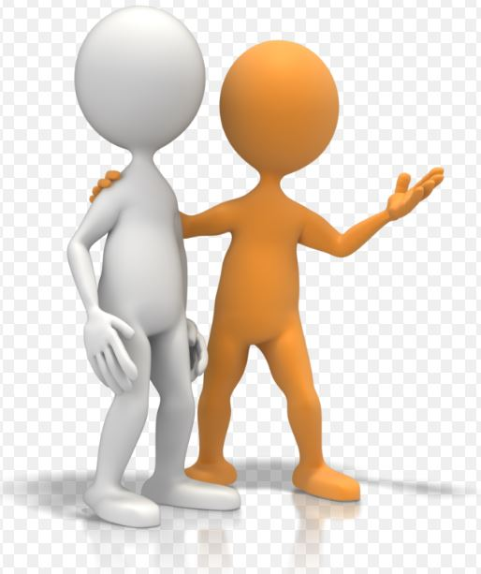
Mentoring
What is mentoring?
Mentoring is most often defined as a relationship in which an experienced person (the mentor) assists another (the mentee) in developing specific skills and knowledge that will enhance the less-experienced person’s professional and personal growth.

Slide 11
Mentoring
What does a mentor do?
The following are among the mentor’s functions:
  Coaches the mentee on a particular skill
  Teaches the mentee about a specific issue
  Facilitates the mentee’s growth by sharing ideas, resources and networks
  Challenges the mentee to move beyond his or her comfort zone
  Creates a safe learning environment for taking risks
  Focuses on the mentee’s total development

Slide 12
Mentoring
Are mentoring and coaching identical?
No. People often confuse mentoring and coaching. Though related, they are not the same. A mentor may coach, but a coach is not a mentor. Mentoring is “relational,” while coaching is “functional.”
Mentoring is about being a role model and at the same time, a peer of the mentee. Mentors develop a personal relationship with mentees.
Coaching is about teaching specific skills and displays a power differential between the coach and the person being coached.

Slide 13
Mentoring
It is not always the roll of a peer supporter to function as a mentor. Receiving mentorship is a choice made by the person receiving support.
Mentoring is a complex relationship and focuses on both short and long-term development goals. The mentor is both a peer and a guide. In peer support the mentor learns along with the mentee and both benefit on the road to recovery.

Slide 14
Mentoring
Goals are established by the mentee and the mentor working together.
  Mentoring is not imposed on the individual it is by mutual agreement.
  Mentors and mentees are paired based on compatibility
  "Compatibility" occurs when individuals work together in harmony to achieve a common purpose. In formal mentoring, that means a more-seasoned person leading someone less experienced in a manner designed to facilitate learning.

Slide 15
Mentoring Skills and Strategies
Be a good example
One of the best attributes of a mentor is leading by example.
After agreeing to take on a mentee, it is the responsibility of a mentor to provide the benefits of their experience.
Monitor negativity, engage in positive activities, and illustrate ways to strategically navigate the road to recovery.

Slide 16
Mentoring Skills and Strategies
Offer problem solving strategies
Everyone faces challenges and the road to recovery is fraught with potential problems.
The measure of an effective mentor is to help a mentee address problems strategically and effectively.
Experience in navigating the system of care may position the mentor to offer specific tools or techniques to resolve a conflict, or connections that lead to solutions.
Mentors should be ready to offer strategies they have used to solve similar problems

Slide 17
Mentoring Skills and Strategies
Encourage excellence
Many studies have indicated the importance of expanding our expectations of ourselves, and mentors are in the perfect position to encourage their mentees to rise to the occasion.
When people meet or exceed their expectations and achieve goals they are encouraged to set new goals that lead to a better life.

Slide 18
Mentoring Skills and Strategies
Offer challenging opportunities
Encourage individuals to investigate the possibilities available to them.
Help mentees to get out of their comfort zone and engage in new activities, have them choose what they want to do.
With support and encouragement mentors may be able to get their mentees to accomplish things they did not even realize they were capable of, and that is one measure of an accomplished mentor.

Slide 19
Mentoring Skills and Strategies
Listen and support
There is no substitute for active and effective listening, and mentors need to be particularly astute listeners.
It is important to anticipate the stresses, doubts, and concerns mentees are struggling to cope with on a day to day basis.
Rather than immediately interrupt with solutions, it is sometimes more effective to get all of the problems, issues and troubles out, and then help the mentee work through a process to come up with their own solutions.
Patience, compassion and understanding are great skills for mentors to utilize.

Slide 20
Role Play, Mentoring
I am very frustrated because I am having trouble getting my doctor to listen to me about the side effects of my new medication. How could you use mentoring to help me achieve my goals.
Let’s try a short role play that should assist me in talking to my doctor. Remember the tools used by a mentor.

Slide 21

Role Play 2, Mentoring
I am thinking about trying to go back to work but I am afraid that I will fail at whatever I try to do.
Let’s have a
conversation
that assists me
in overcoming
my fears.

Slide 22

Shared Learning
What is shared learning?
Shared learning is the process of
working collectively to achieve a
common objective in a group. The
group tends to share knowledge
and complement each others skills. If there is no commitment and effort from the collective then working and learning together may fail.
Peer support is a shared learning experience.

Slide 23
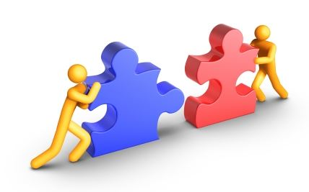
Shared Learning
The Helper Principle!
The helper principle is an age old therapeutic approach that holds that when a person who has experienced or is experiencing a major problem helps someone else with a similar problem the helper is helped as much as or more than the person receiving help. Both parties learn and grow from the experience. It is a guiding principle of peer support.

Slide 24
Shared Learning
The main principles of shared learning are
  Creating the context and environment that empowers people to action
  Learning from experience
  Learning what has and what has not worked well.
  Acknowledging that individuals have the capability and capacity to effect change, and that by working collectively the group strengthens that capability.

Slide 25
Shared Learning
Learning is:
  The process through which ideas, information, beliefs, values, and attitudes are created.
  The way in which we accumulate knowledge to shape the information we need and the ideas that we form.
  Critical learning leads to the meaningful selection of information, the creation of new ideas, and to critical knowledge.

Slide 26
Shared Learning
Learning is not:
  Just receiving knowledge verbatim from books, experts and teachers.
  Entirely behavioristic.
  The strengthening of bonds between stimuli and correct responses.
  That learners are blank slates ready to be filled with knowledge.
  That skills and knowledge are acquired independent of our experience and awareness of the world around us.

Slide 27
Shared Learning
Knowledge:
  Is something we all use, test, question and create.
  Is derived from information, our experience, values, attitudes and beliefs about the world.
  Is tied to action….knowing what we know and what we need to know to work effectively to bring about change.
  Grows into wisdom when it allows us to make sensible decisions and create plans of action.
  Is tied to cycles of critical reflection in which we plan-act-observe-reflect. This is the cycle of learning.

Slide 28
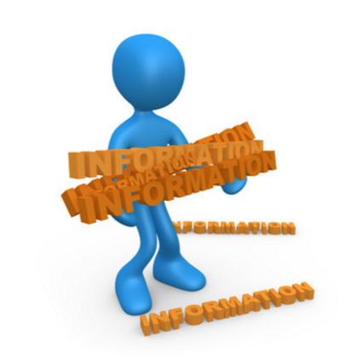
Shared Learning
Information:
  Is the more tangible facts, figures, organizational know how, policies and systems that help people function effectively.
  Can be more easily quantified, captured and exchanged than knowledge.
  While information may inform
  the creation of knowledge,
  it does not constitute knowledge.

Slide 29
Collaborative Learning
Collaborative learning is a method of teaching and learning in which “students” team together to explore a significant question or create a meaningful project.
Cooperative learning is a specific kind of collaborative learning. In cooperative learning “students” work together on a structured activity. They are individually accountable for their work and as a team.

Slide 30
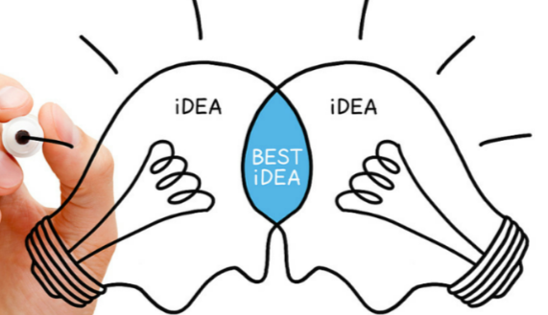
Collaborative Learning
In order for collaborative learning to take place:
  People need to feel safe.
  The learning goals need to be clearly defined.
  The team members (the
  helper and the helpee)
  must be compatible and
  able to work together.

Slide 31
Relationship Building
Basic Skills for building good relationships:
  Good Communication: knowing how to listen, share your thoughts and honest feelings, refraining from criticizing.
  Encourage the other person to share their feelings. The message you intend to send is not always the message which is received.
  Conflict Resolution: stay focused on the topic, stay focused on the present, be ready to forgive or apologize, and know when to take a break.

Slide 32
Relationship Building
Learn to Know the Other Person: simply knowing a lot about the other person is a powerful way to show you care, and makes you better able to attend to their goals and needs.
Self-Management: people who are skilled at self-management know their strengths and barriers and always strive for improvement.

Slide 33
Relationship Building
  Stress Management: Learn to deal with stress by using relaxation techniques like breathing or meditation.
  Be Authentic: to be authentic you must be transparent in your motives and trustworthy in your behavior.
  Respectful: consider the other persons feeling. Ask yourself how you would like to be treated in a given situation. Treat everyone with respect and courtesy.

Slide 34
Relationship Building
Keep to your word and follow through with your actions. Be careful not to make commitments that you cannot keep.
Learn to say “No” if you are not sure that you can keep your commitments.
If you fail to say “No” you will end up taking on more than you can manage, and your will erode the trusting relationship you are trying to build.

Slide 35
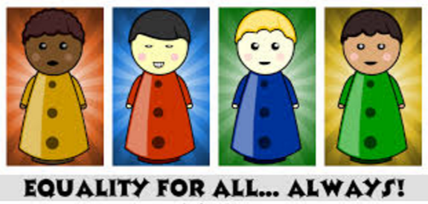
Relationship Building
Good relationships are built where there is mutual understanding, trust, and equality between individuals.
Mentoring, Shared Learning and Relationship Building

Slide 36

Friendship!
Let’s talk about the power of friendship

Slide 37
Mentoring, Shared Learning and Relationship Building
Peer Support Master Class
2018
Patrick Hendry Vice President PASS
phendry@mentalhealthamerica.net
A program of

