Slide 1


Foundations of Healthcare
Systems
Peer Support Master Class
2018
A program of

Slide 2
Integrated Healthcare
The link between physical health and mental health has never been so clear.
We now know that there is no (good) health without mental health.
The healthcare system has begun to move to an integrated system of care, combining primary health with behavioral health.

Slide 3

Integrated Healthcare
This system provides the availability of treatment for physical health, and mental health conditions or addictions whether the person is seen in behavioral health or primary care.

Slide 4
Integrated Healthcare
Discuss how primary care is now being offered at community mental health centers.
Discuss how mental health services fit into primary care.

Slide 5

Integrated Healthcare
Poor physical health can lead to increased risk of developing mental health problems.
Similarly poor mental health can negatively impact on physical health leading to an increased risk of some conditions

Slide 6
How Mental Health Affects Physical Health
Depression has been linked to:
  67% increased risk from heart disease
  50% increased risk from cancer
Schizophrenia is associated with:
  Double the risk of death from heart disease
  Three times the risk of death from respiratory disease
This is most likely because people with mental health conditions are less likely to receive the physical healthcare they’re entitled to.
Mental Health Foundation

Slide 7
How Physical Health Affects Mental Health
The promotion of positive mental health can often be overlooked when treating a physical condition.
Many health conditions have severe implications for our quality of life, frequently leading to depression and anxiety.
A healthy physical lifestyle incorporating exercise can:
    Reduce anxiety
    Increase mood
    Enhance overall mental health Bradley University

Slide 8
Integrated Healthcare
Discuss ways in which mental health affects physical health.
Discuss ways in which physical health affects mental health.

Slide 9
Healthcare Settings and Peer Support
Peer support can be provided in a wide range of settings:
  In the community
  In peer-run centers
  Community behavioral health
  Private behavioral health
  Emergency rooms
  Mobile crisis teams
  In-patient settings
  Primary care clinics
  Jails and prisons

Slide 10
Healthcare Settings and Peer Support
Let’s go through them, discuss how peer support can be provided in each of these settings.
  In the community
  In peer-run centers
  Community behavioral health
  Private behavioral health
  Emergency rooms
  Mobile crisis teams
  In-patient settings
  Primary care clinics
  Jails and prisons

Slide 11
The Many Faces of Peer Support
The roles and activities of peer supporters in services can vary depending on their setting. These roles include:
  Working one-to-one with people
  Supporting people through transitions such as from hospitals to home and from mental health services to community based supports and into employment.
  Assisting people in access local opportunities they feel will improve their wellbeing.
  Facilitating recovery education, mutual support, and self-help groups.
  Supporting people to use self-management tools including WRAP and WHAM.

Slide 12
The Roles of Healthcare Providers
Discuss the roles of:
  Psychiatrists
  Psychologists
  Social Workers/Mental health counselors
  Case managers
  Primary care physicians
  Nurses
  Specialty doctors
  Community health workers

Slide 13
The Roles of Healthcare Providers
Community Health Workers are relatively new. Their duties can include:
  Create connections between vulnerable populations and healthcare systems.
  Facilitate healthcare and social service system navigation.
  Manage care and care transitions for vulnerable populations
  Ensure cultural competence among healthcare professionals serving vulnerable populations.
  Provide culturally appropriate health education on topics related to chronic disease prevention, physical activity and nutrition.
  Advocate for underserved individuals to receive appropriate services.
  Provide informal counseling, health screenings and referrals.

Slide 14
Peer Specialists Compared to Community Health Workers
How might the roles of peer specialists overlap with community health workers?
How are the roles different?

Slide 15
The Work of Peer Specialists is Never Clinical
In working in a clinical setting a peer may be part of a care team made up of primarily clinicians.
The peer is a “valuable, independent member of the team who offers the unique insight from the point of view of a peer with shared experience”.
Peers “may also provide solutions to improve recovery orientation of the clinic and in developing richer recovery supports”.
New York Office of Alcoholism and Substance Abuse Services

Slide 16
The Roles of Healthcare Providers
Discuss the role of a peer support worker in a clinical setting.
Discuss the role of a peer support worker as part of a care team.

Slide 17
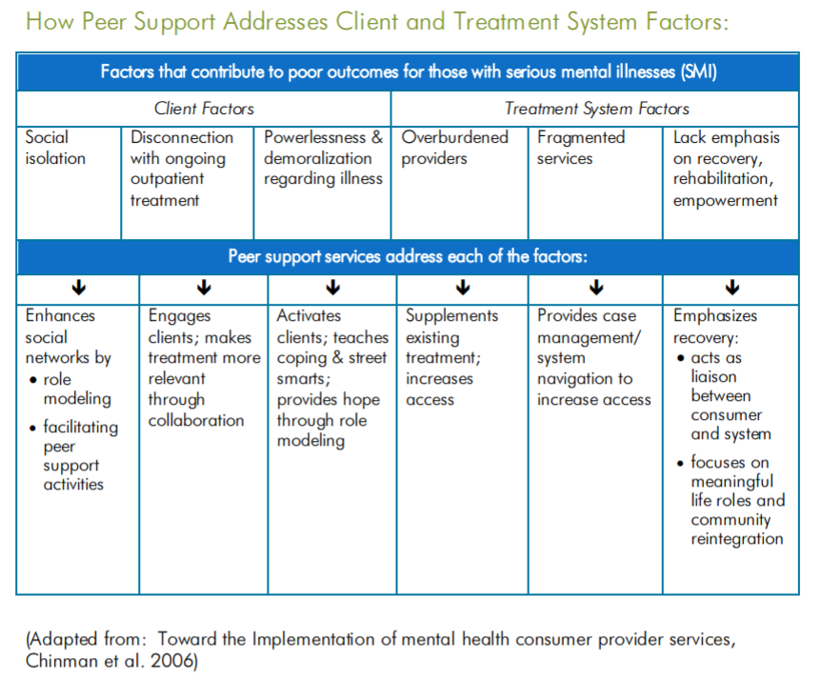

Slide 18
Traditional Treatment Modalities
Why would a peer specialist want to know about clinical treatment modalities if we all agree that peer support is never a clinical service?

Slide 19
Traditional Treatment Modalities
Because the a CPS acts as a systems navigator and can explain unknown terms to the individuals they serve.
Here are a few types of services an individual may come in contact with.

Slide 20
Traditional Treatment Modalities
Crisis Intervention: Crisis intervention therapy aims to intervene as quickly as possible after a traumatic event has occurred. Its’ goals are to minimize destructive coping skills and create positive coping techniques.
Cognitive Behavioral Therapy: This model stems from the idea that people are characterized by how they think of the world, and that the way they think and interpret events leads to emotional responses. The goal is to identify and change irrational of destructive thoughts that are causing negative emotions and reactions.

Slide 21
Traditional Treatment Modalities
Client Centered Therapy: This is focused on the therapist establishing a warm, safe environment for the individual and providing genuine empathy.
Solution Focused Therapy: This seeks to establish goals and solutions to a persons problem that utilize their strengths. The individual sets their own goals and the therapist aids through psycho education and interactive counseling.

Slide 22
Traditional Treatment Modalities
Medication and Medication Management: This is a treatment of mental health symptoms and the maintenance of the individual on long term medications. It assures that each medication is appropriate for the individual, effective for the condition, safe given the comorbidities and other medications being taken.
Taking medication is a personal choice. Many people have found their way to recovery without meds.

Slide 23
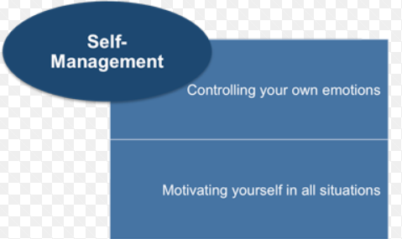
Traditional Treatment Modalities
Dialectical Behavioral Therapy: DBT is a modified form of Cognitive Behavioral Therapy that is designed to help people who react abnormally to emotional stimulation. This approach works towards helping people increase their emotional and cognitive regulation by learning the
triggers that lead to
reactive states and
helping assess which
coping skills to apply
to help avoid
undesired reactions.

Slide 24

Non-Traditional Treatment Modalities
Guided Imagery: Guided imagery is a self-directed relaxation tool that helps people regain control by reducing anxiety and anger. It helps people confront traumatic memories using indirect symbolism and metaphors, and works to naturally elevate serotonin-like neuro hormones.

Slide 25

Non-Traditional Treatment Modalities
Meditation: There are many forms of meditation. There is concentrative meditation in which you sit or lie comfortably and concentrate on your breathing. In mindfulness meditation you relax comfortably and observe your surroundings without forming judgements. For transcendental meditation you need to close your eyes and try to empty your mind. With meditation you can slow down your breathing, heart rate and lower blood pressure. It can relieve the symptoms of stress and anxiety.

Slide 26

Non-Traditional Treatment Modalities
Creative Therapies: Creative therapy involves using art, dance, and drama to promote self-awareness, express trauma, aid communication and facilitate change. These techniques are often used for individuals who have difficulty verbalizing their emotions.

Slide 27
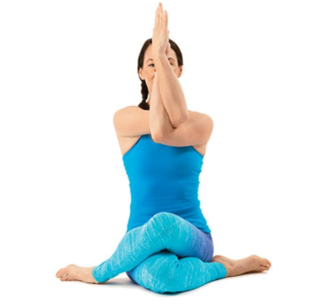
Non-Traditional Treatment Modalities
Yoga: Yoga moves you from the fight-or-flight mode to rest-and-digest or consider. You typically have less anxiety and enter a more relaxed state. It increases your sense of self and has overall health benefits through stress relief and physical toning.

Slide 28
New Treatment Modalities
Nutrition: The emerging field of nutritional psychiatry is finding that there are many consequences and correlations between what you eat and how you feel and ultimately behave. S
Serotonin is a neurotransmitter that helps regulate sleep and appetite, mediate moods, and inhibit pain.
Approximately 95% of your serotonin is produced in your gastrointestinal tract and your gastrointestinal tract is lined with hundreds of millions or nerve cells or neurons.

Slide 29
The Finances of Healthcare
How are healthcare services paid for?

Slide 30
The Finances of Healthcare
Medicare: Responsible for 20% of healthcare costs
Medicaid: Responsible for 17% of costs
Veterans Administration 3% of costs
State tax dollars
Private pay (cash) 11%
Sliding scale (based on income)
Private health insurance (including co-pays and deductibles) Responsible for 34% of healthcare costs
Other 3rd parties 8%

Slide 31
The Finances of Healthcare
What is Parity?

Slide 32
The Mental Health Parity and Addiction Equity Act (MHPAEA)
The Paul Wellstone and Pete Domnici MHPAEA of 2008 is a federal law that generally prevents group health plans and health insurance issuers that provide mental health or substance use disorder benefits from imposing less favorable benefit limitations on those benefits than on medical/surgical benefits.

Slide 33
Parity
Mental health parity refers to the equal treatment of physical health and mental health or substance use disorders.
Behavioral health is provided in the same way that other health conditions are. Parity is “equal coverage”.
Certain health plans are exempted from the parity law.

Slide 34
Parity
Health plans exempted from the parity law
  Most types of Medicare
  Medicaid fee for service plans
  “Grandfathered” plans that were in place prior to the enactment of the parity law.
  Some plans that receive an exemption because of increased costs related to parity

Slide 35
Challenges for the Peer Community
Name some important challenges facing the peer community and peer support.

Slide 36
Challenges for the Peer Community
The peer community currently faces a number of important challenges.
  States restricting access to Medicaid services
  In some states a work requirement for Medicaid
  Available services are often inadequate to meet the need.
  The increasing movement towards placing peer support under clinical supervision.
  The tendency of some providers to attempt to attempt to use peer support as a clinical services.

Slide 37
Foundations of Healthcare
Systems
Peer Support Master Class
2018
Patrick Hendry, Vice President, Peer Advocacy, Supports & Services
phendry@mentalhealthamerica.net

