Slide 1


Enhanced Goal Setting and Decision Making Excerpts from WHAM & The Center for Integrated Health Solutions
Peer Support Master Class
2018
A program of

Slide 2
Goal Setting
Many people living with psychiatric disorders have a hard time setting future goals.
Most initial goals are simple & narrow
  “I want to stay on my meds.”
  “I want to stay out of the hospital”

Slide 3

Possibilities
One of the most rewarding jobs of a Peer Specialist is to help people broaden their horizons.
  Your world does not have to be defined by your illness.
  There a many possibilities available that will help you live a more enjoyable, meaningful life.

Slide 4

Goal Setting
Some of the people you work with will have whole health or social goals.
  “I want to lose weight.”
  “I want to meet new people.”
  “I want to exercise more.”

Slide 5
Let’s Set Some Goals
My goal is ______________________

Slide 6
What is a Goal?
A goal is something we want that we are willing to work for because we want the benefits.
The core of a goal is the thing that is so important to us that we are willing to make real changes in our actions, relationships, health, in our lives.
“If you’re not willing to make the necessary sacrifices to attain your goals and objectives, then you will fail to create the momentum you need to get your desired outcomes.”
Blog: Adam Sicinski

Slide 7

What is a Goal?
There are multiple levels to our goals. We might say that our goal is to complete some activity but as we look deeper there are layers to why we want to accomplish that.
The ultimate goal is also called the “Benefit”.

Slide 8
Ask the Four Questions
If someone states their goal as “ I want to lose weight.”
Ask:
  “Why do you want to lose weight”
  “ Because I want to feel better about myself.”
  “What will the benefits of this be?”
  “ I won’t be so self conscious.”
  “ How will your life be different?”
  “ I will feel like going out of my house more often.”
  “ If you accomplish this, what will you be able to do that you can’t or aren’t doing now?”
  “I’ll be able to meet new people and make new friends.”
That is the real benefit!

Slide 9

Restate the Goal
“ So maybe your real goal is to make new friends, and losing weight is a interim goal to achieve that benefit.”

Slide 10

Checking Your Goal
Why do you want this goal?
What will the benefits of this be?
How will your life be different?
If you accomplish this, what will you be able to do that you can’t or aren’t doing now?

Slide 11
Use This Format to State Your Goal
“In order to make new friends, I will lose weight so that I will feel better about myself, go out more often and meet new people, and I will do this over a six month period”

Slide 12
Looking at Your Goal Using the IMPACT Criteria
I: Does it Improve the quality of your life?
M: Is it Measurable in terms of knowing if I have accomplished it?
P: Is it Positively stated as something new I want in my life?
A: Is it Achievable in my present situation with my current abilities?
C: Does it Call forth actions that I can take on a regular basis to create healthy habits?
T: Is it Time limited in terms of when I will begin and when I will accomplish it?

Slide 13
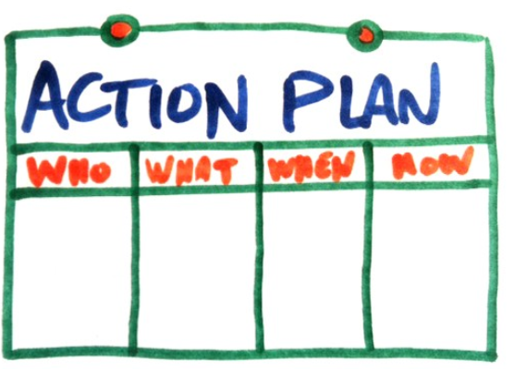
Create an Action Plan
Learning to create an action plan that helps a person reach his or her goal is crucial to success. The actions must be things that the person can do on a regular basis in order to create a new habit.

Slide 14
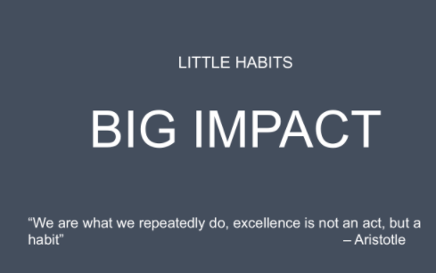
Create an Action Plan
While the actions may vary from week to week as the person progresses towards their goal, they need to relate directly to the goal and benefit and help create a new discipline in one’s lifestyle.

Slide 15
Create an Action Plan
  List out some specific actions you can take towards your goal.
    Some of the things I could possible do, or need to do, each week to accomplish my goal are:
      ________________________________
      ________________________________
      ________________________________
      ________________________________

Slide 16
Create an Action Plan
The plan should answer the following questions:
  What will I do?
  How much will I do?
  How often will I do it?
  When will I do it.

Slide 17
Confidence Scale
Once you created a plan the question is will you implement it?
Continued success increases one’s self-confidence and the desire to set and accomplish more goals.
Decide how confident you are that you will accomplish that weeks plan based on a scale of 1-10 with 10 being the most confident.
Your score should be 7 or higher.

Slide 18

Confidence Scale
If it is below 7 you can increase it by:
  Lessening the actions (how many or how much)
  Identifying and adjusting the barriers
  And/or increasing the support you may need to succeed.
    Example: You may have a friend remind you on a regular basis.

Slide 19
Confidence Scale
How confident are you about achieving your goal?
What can you do to make yourself more confident?

Slide 20
Keep Track of Your Progress
By writing out your plan you can also keep track of how well you followed it.
Check off or write down each action step you accomplish.
Measuring your success with your plan will help you realize when you’ve accomplished your goal!

Slide 21
Enhanced Goal Setting
Presented by:
Patrick Hendry
phendry@mentalhealthamerica.net
(703) 838-7538
www.mentalhealthamerica.net

