Slide 1


Activation and Self-Management
Peer Support Master Class
2018
A program of

Slide 2

Activation
When we talk about “activation” in mental health we are referring to the process for becoming self-aware and motivated to understand one’s role in the care process and having the knowledge, skill, and confidence to manage one’s health and health care”.

Slide 3

Activation and Self-Management
There is a growing awareness that people should be more active and effective managers of their health and health care. Recent studies have found that activation – or having the knowledge, skills and confidence to manage one’s health is related to better health outcomes

Slide 4
Activation
The primary methods to activate people to take a more active role in their health care are to educate them about their situation and possibilities for recovery and improved health, and to empower them to participate as equal partners in their personal health care decisions.

Slide 5
Activation & Self-Management
Activation leads to “Self-Management”. This is about transferring the focus from treating a condition or illness to enabling people to make the decisions that improve their lives, whether these are viewed through a neurological, biochemical, psychological, social or spiritual lens. WHO

Slide 6
Activation & Self-Management
Self-management is not pro nor antipsychiatry, nor is it the preservation of any ideology. For many people the classic narrative following diagnosis is one of hopelessness, lack of self-esteem, loss of life opportunities and loss of control.
Dealing with mental ill health and its many consequences is a challenging experience for which there is nothing to prepare people.
Historically clinicians and services have focused on managing symptoms and relieving suffering. Self-management offers the opportunity of enabling people to rebuild their lives within the context of living with a diagnosis. WHO

Slide 7
Activation & Self-Management
Self-management is a structured approach to transferring control back to the individual that should improve clinical relationships by making partnerships more equal. (Shared Decision Making)
It should also improve the way in which individuals and their caregivers work together by providing a framework for constructive, caring relationships.
Although self-management is a well established and evidence based approach to a number of long term medical conditions, it is still a relatively new one for people with serious psychiatric diagnoses. World Health Organization (WHO)

Slide 8
Self-Management in Mental Health
Self-management is about the methods, skills, and strategies we use to effectively manage our own activities towards achieving certain objectives.
For those of us who live with long-term mental health conditions this means concentrating on interventions and developing training and skills to take care of, and gain control over, our lives.
Mental Health Foundation

Slide 9

The Role of Peer Support in Teaching Self-Management
How can peer support help people overcome the towards self-management?

Slide 10
The Role of Peer Support in Teaching Self-Management
Peer support can help move people towards self-management by teaching some basic skills:
  Recognizing what triggers a crisis in your mental health.
  Reading the warning signs of a possible crisis.
  Identifying if any particular actions can prevent a crisis.
  Figuring out which coping strategies work best for you in a crisis.

Slide 11
The Role of Peer Support in Teaching Self-Management
  Tapping into other sources of support like local groups for people experiencing distress
  Building ongoing coping strategies into a mentally healthy lifestyle.
  Completing an action plan.
  Drawing up an advance directive setting out how you’d like to be treated if you ever lack the capacity to make decisions about treatment in the future.

Slide 12
The Role of Peer Support in Teaching Self-Management
“A peer support worker helps coach people to cope better and move on to something more sustainable. Peer support workers do not tell people what to do but empower them to do it for themselves.”
Exploring Peer Support as an Approach to Supporting Self-Management

Slide 13
The Role of Peer Support in Teaching Self-Management
“Community and voluntary groups play an important role in boosting people’s confidence and getting them involved in their community. Many are formed to support people living with specific conditions; provide disease-specific education and training; allow peer support with people in similar circumstances; provide advocacy support; and lobby for service change and improvements. In order to better self mange their health, patients need to be able to find out about national and local support groups and organizations.”
High Impact Changes,2009

Slide 14
The Role of Peer Support in Teaching Self-Management
“Recovery needs to be adopted as a concept relating to self respect, spirit, self esteem and sense of self. While people are generally unlikely to recover from the condition itself, effective management of symptoms balanced with increased autonomy and independence can help recover optimum wellbeing.”
Guan Yersel, 2007

Slide 15
The Role of Peer Support in Teaching Self-Management
Recent literature reviews on peer support in mental health and a number of evaluations of peer support pilots in prison, community and mental health care settings, including the Scottish Government’s Delivering for Mental Health peer support worker pilots in 2009 demonstrate the significant positive impacts on peer workers and those receiving peer support in terms of their ability to self manage their mental wellbeing and live fulfilled lives.
Exploring Peer Support as an Approach to Supporting Self-Management

Slide 16
The Role of Peer Support in Teaching Self-Management
What is the nature of the peer relationship?
Peer support cannot exist without the peer relationship. What is deemed to constitute a peer and a peer based relationship will vary by the individual requiring support and the care providers delivering a peer service. In that relationship there are always at least two people. Between people a number of different elements may be more or less important in terms of establishing a good peer relationship

Slide 17

The Role of Peer Support in Teaching Self-Management
When asked to really look at what it is that makes peer support successful, participants stated empathy and trust. Identifying peer connections can increase the chances of facilitating a good relationship with empathy and trust as central components.
Exploring Peer Support as an Approach to Supporting Self- Management

Slide 18
The Skills Peers Need to Assist Individuals in Moving to Self-Management
Needs assessment and goal setting skills
  By listening to the person peers should be able to assess the needs and readiness of the individual to engage in self management.
  They also need to be able to identify when it is not appropriate or worthwhile to start the process.
  To assess the support, training and information needs of individuals, peers should have the ability to identify individuals’ strengths and weaknesses regarding self management.
  Peers need to help people identify their self management outcomes and how to achieve them.

Slide 19
The Skills Peers Need to Assist Individuals in Moving to Self-Management
Communication skills:
  Talking about mental wellbeing issues is difficult for most people.
  Peers need to have the ability to relate to people and identify their issues.
  It is important that a peer can make sure the person is equipped with the support and reassurance they need to share their experiences.

Slide 20
The Skills Peers Need to Assist Individuals in Moving to Self-Management
Motivational skills
  Peers need to be able to impart motivational support. This might include having knowledge of the link between activation levels and self management success.
  They need to be able to engage with people and encourage them to get involved and to learn more about their condition(s).

Slide 21

The Skills Peers Need to Assist Individuals in Moving to Self-Management
Role modelling
  One participant suggested that peers share their own light bulb moments as a motivational tool.
  The role modelling that peers can offer was identified by some participants as the key to the help they provide.

Slide 22
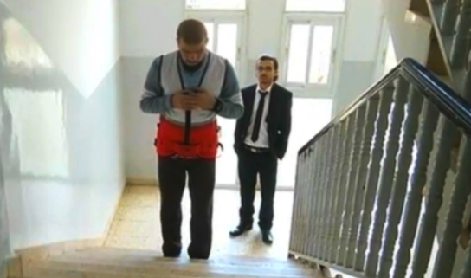
The Skills Peers Need to Assist Individuals in Moving to Self-Management
Knowledge of the care system
  Knowledge of the care system and the ability to guide people through the steps following diagnosis was thought to be an important capability for peer workers.

Slide 23
The Skills Peers Need to Assist Individuals in Moving to Self-Management
Ability to empathize and show understanding:
  Peer support should be empathetic and help people transition from diagnosis to self management.
  This means they need awareness of the impact of a long term condition on individuals’ personal, social and working lives.
  Peers also need to be aware of health inequality issues and the challenges that an individual’s situation in society may impose on their ability to self manage (e.g. poverty, ethnicity)
“Not everyone can do it... they need the ability to empathize about where the individual they support is coming from and to realize that they are different from them.” Anonymous

Slide 24
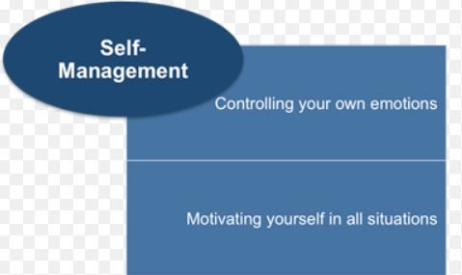
The Skills Peers Need to Assist Individuals in Moving to Self-Management
Ability to self manage their own condition
  In order to support others, the peer needs to be in a good place with their own recovery, mentally and physically successfully self managing.
  For participants, knowledge and skills about self management are central to the peer worker role.

Slide 25
The Skills Peers Need to Assist Individuals in Moving to Self-Management
Relationship management skills:
  Peers need to have the skills to establish boundaries with the individual and know when the individual’s support needs are beyond the peer.
  They need the ability not to be drawn in to a victim/ survivor relationship, as the aim of peer support is for the individual to stand on their own two feet.

Slide 26
Skillsets Needed
Name the 8 skillsets needed to assist an individual move towards self-management.
Don’t look at your printout, please

Slide 27
Who Benefits from Learning Self-Management Skills?
People who want to start rebuilding their lives
  Identify those who are ready to self manage following a diagnosis and who want to start engaging with support services.
  Need to be guided by someone who is already actively self managing, who does not “do” for them but supports them to find their own way through the maze of options.
  Peer support workers feel that this is a valuable part of the peer support role, and a way for people with long term conditions to give something back.

Slide 28

Who Benefits from Learning Self-Management Skills?
“There is something within each long term condition that will impact on an individual’s mental wellbeing and merits support for self management and peer support.”
Mental Health
Foundation

Slide 29
Motivation Towards Self-Management
Motivating and supporting people with their own self management aims:
  Many individuals feel that peer support groups go towards meeting the self management aim.
  Longer term groups and one-to-one services keep people motivated to maintain their physical and mental wellbeing and be their partner in care.
For some individuals, entering a peer support service can be the first time they have support that is not medical, and this can bring a unique and personal dimension to the support they receive.

Slide 30

Motivation Towards Self-Management
“Self management is something that a person has to do for themselves but they need support from others to do so. Peers with self management experience are the ideal support.”

Slide 31
Activation
What is “Activation” and how is it done?

Slide 32
Role Play
Explain to me what self-management is and what are some of the skills involved. Interview me to see if I am a good candidate for self-management and work with me to activate my own management.

Slide 33
Activation and Self-Management
Peer Support Master Class
2018
Patrick Hendry VP PASS
phendry@mentalhealthamerica.net
A program of

